Slide 1
Second Master Seminar Talk
Consistency of the well-ordering theorem
Felix Rech
Advisor: Dominik Kirst
October 30, 2019
L
The Universe of
Constructible Sets

Slide 2
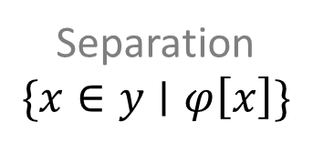
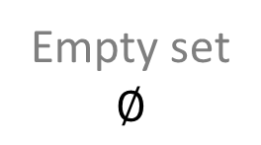
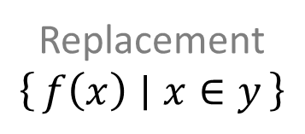
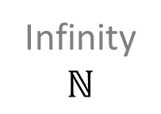

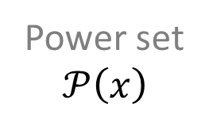
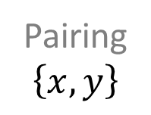
Zermelo-Fraenkel Set Theory (ZF)
We work in first-order logic with a sort of sets and a binary element relation $∈$.
Axioms
Power set
$$𝒫\left(x\right)$$
Extensionality
Empty set
$$∅$$
Pairing
$$\left\{x,y\right\}$$
Union
$$⋃x$$
Foundation
Infinity
$$ℕ$$
Replacement
$$\left\{f\left(x\right) ∣ x∈y\right\}$$
Separation
$$\{x∈y∣φ\left[x\right]\}$$

Slide 3
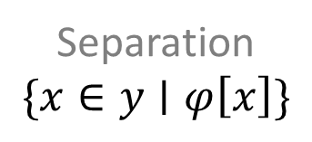
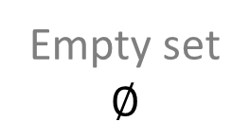

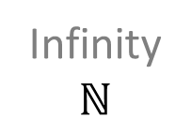

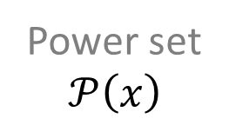
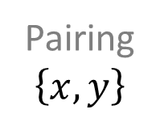
Zermelo-Fraenkel Set Theory (ZF)
We work in first-order logic with a sort of sets and a binary element relation $∈$.
Axioms
Power set
$$𝒫\left(x\right)$$
Empty set
$$∅$$
Extensionality
Pairing
$$\left\{x,y\right\}$$
Union
$$⋃x$$
Foundation
Infinity
$$ℕ$$
Replacement
$$\left\{f\left(x\right) ∣ x∈y\right\}$$
Separation
$$\{x∈y∣φ\left[x\right]\}$$

Slide 4
A well-order is a total order under which
every non-empty subset has a smallest element.
Well-Ordering Theorem
Every set has a well-order.
(Equivalent to the axiom of choice)
This is independent of ZF.
Some models satisfy it,
some models don’t.

Slide 5
















Ordinals – Counting past infinity
$$⋯$$
$$3$$
$$ω+2$$
$$ω⋅2+1$$
$$ω⋅3$$
$$ω^{2}+2$$
$$2$$
$$ω+1$$
$$ω⋅2$$
$$ω^{2}+1$$
$$1$$
$$1$$
$$ω$$
$$ω^{2}$$
$$0$$
$$0$$
Every set of ordinals has an upper bound.

Slide 6
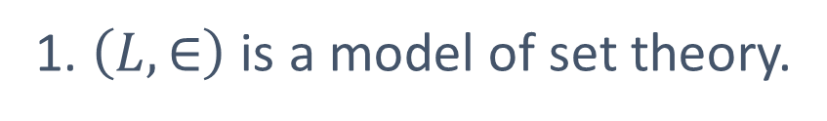

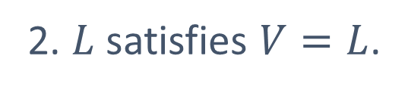

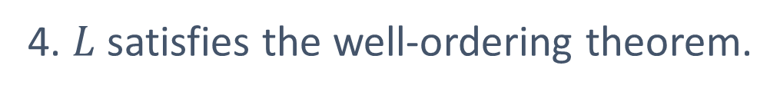
Proof of Consistency (Outline)
[Smullyan and Fitting]
We work inside set theory.
0. We define a class $L$.
1. $\left(L, ∈\right)$ is a model of set theory.
2. $L$ satisfies $V=L$.
3. We can well-order $L$.
4. $L$ satisfies the well-ordering theorem.

Slide 7












0. We define a class $L$.
The Constructible Universe
$$L$$
$$⋮$$
$$⋮$$
$$L_{ω+2}$$
$$L_{ω+1}$$
$$L_{ω}$$
$$⋮$$
$$L_{3}$$
$$L_{2}$$
$$L_{1}$$
$$L_{0}$$
7

Slide 8

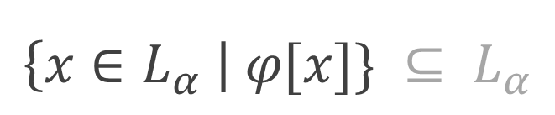
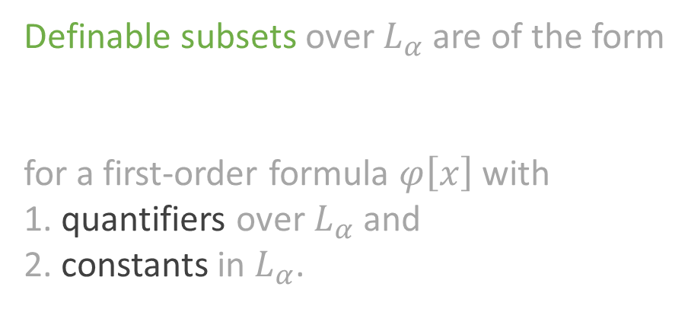

0. We define a class $L$.
The Constructible Universe
$$L_{0} ≔∅ \\ L_{α+1}≔definable subsets over L_{α} \\ L_{λ} ≔ \bigcup_{α<λ}{ L_{α}} \\ L ≔\bigcup_{α∈Ord}{L_{α}}$$
$$L$$
$$⋮$$
$$⋮$$
$$L_{ω+2}$$
$$L_{ω+1}$$
$$L_{ω}$$
$$⋮$$
$$L_{3}$$
Definable subsets over $L_{α}$ are of the form
for a first-order formula $φ\left[x\right]$ with
1. quantifiers over $L_{α}$ and
2. constants in $L_{α}$.
$$L_{2}$$
$$\left\{x∈L_{α} \right| φ[x]\} ⊆ L_{α}$$
$$L_{1}$$
$$L_{0}$$
8

Slide 9
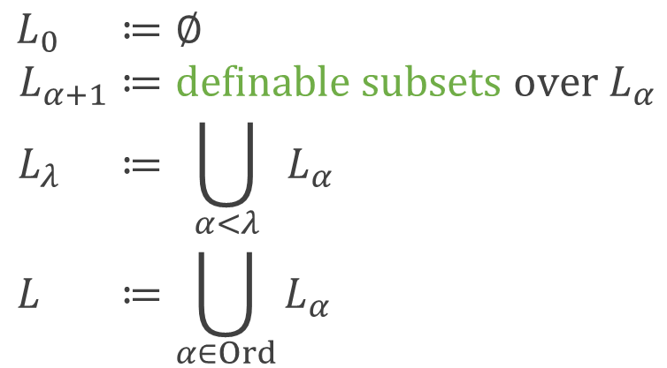
0. We define a class $L$.
The Constructible Universe
$$L_{0} ≔∅ \\ L_{α+1}≔definable subsets over L_{α} \\ L_{λ} ≔ \bigcup_{α<λ}{ L_{α}} \\ L ≔\bigcup_{α∈Ord}{L_{α}}$$
$$L$$
$$⋮$$
$$⋮$$
$$L_{ω+2}$$
$$L_{ω+1}$$
$$L_{ω}$$
$$⋮$$
$$L_{3}$$
Definable subsets over $L_{α}$ are of the form
for a first-order formula $φ\left[x\right]$ with
1. quantifiers over $L_{α}$ and
2. constants in $L_{α}$.
$$L_{2}$$
$$\left\{x∈L_{α} \right| φ[x]\} ⊆ L_{α}$$
$$L_{1}$$
$$L_{0}$$
9

Slide 10
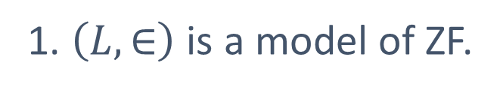
Proof of Consistency (Outline)
[Smullyan and Fitting]
We work inside set theory.
0. We define a class $L$.
1. $\left(L, ∈\right)$ is a model of ZF.
2. $L$ satisfies $V=L$.
3. We can well-order $L$.
4. $L$ satisfies the well-ordering theorem.

Slide 11
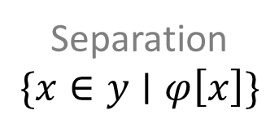

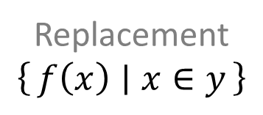
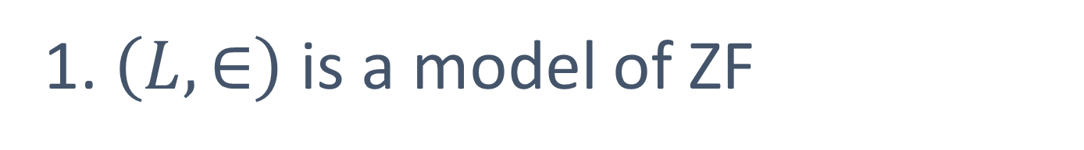
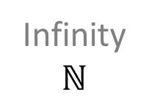

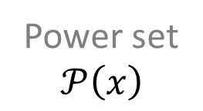

1. $\left(L, ∈\right)$ is a model of ZF
Power set
$$𝒫\left(x\right)$$
Extensionality
Empty set
$$∅$$
Pairing
$$\left\{x,y\right\}$$
Union
$$⋃x$$
Foundation
Infinity
$$ℕ$$
Replacement
$$\left\{f\left(x\right) ∣ x∈y\right\}$$
Separation
$$\{x∈y∣φ\left[x\right]\}$$
11

Slide 12
1. $\left(L, ∈\right)$ is a model of ZF – Extensionality
$${ ∀A,B.\left(∀x.x∈A↔x∈B\right)→A=B }^{L}$$

Slide 13
1. $\left(L, ∈\right)$ is a model of ZF – Extensionality
$${∀A,B∈L. {\left(∀x.x∈A↔x∈B\right) }^{L}→ A=B }^{L}$$

Slide 14
1. $\left(L, ∈\right)$ is a model of ZF – Extensionality
$${∀A,B∈L.\left(∀x∈L.{ x∈A }^{L}↔{ x∈B }^{L}\right)→ A=B }^{L}$$

Slide 15
1. $\left(L, ∈\right)$ is a model of ZF – Extensionality
$${∀A,B∈L.\left(∀x∈L.{ x∈A }^{L}↔{ x∈B }^{L}\right)→ A=B }^{L}$$

Slide 16
1. $\left(L, ∈\right)$ is a model of ZF – Extensionality
$${∀A,B∈L.\left(∀x∈L.{ x∈A }^{L}↔{ x∈B }^{L}\right)→ A=B }^{L}$$

Slide 17
1. $\left(L, ∈\right)$ is a model of ZF – Extensionality
$${∀A,B∈L.\left(∀x∈L.{ x∈A }^{L}↔{ x∈B }^{L}\right)→ A=B }^{L}$$

Slide 18

1. $\left(L, ∈\right)$ is a model of ZF
Power set
$$𝒫\left(x\right)$$
Extensionality
Empty set
$$∅$$
Pairing
$$\left\{x,y\right\}$$
Union
$$⋃x$$
Foundation
Infinity
$$ℕ$$
Replacement
$$\left\{f\left(x\right) ∣ x∈y\right\}$$
Separation
$$\{x∈y∣φ\left[x\right]\}$$
18

Slide 19
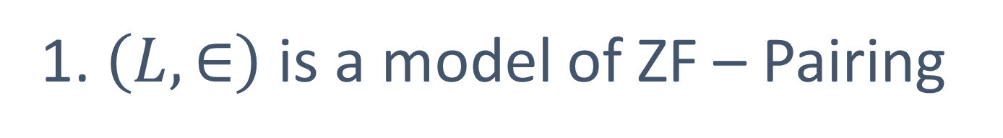
1. $\left(L, ∈\right)$ is a model of ZF – Pairing

Slide 20
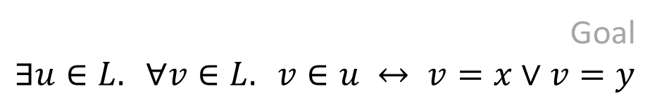

1. $\left(L, ∈\right)$ is a model of ZF – Pairing
Fix $x,y∈L$.
Goal
$$∃u∈L. ∀v∈L. v∈u ↔ v=x∨v=y$$

Slide 21
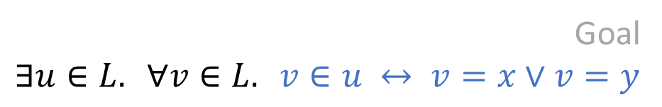
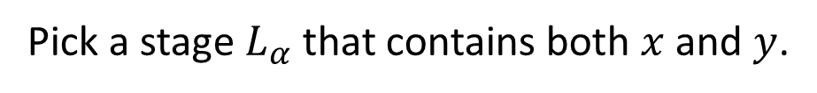
1. $\left(L, ∈\right)$ is a model of ZF – Pairing
Fix $x,y∈L$.
Goal
$$∃u∈L. ∀v∈L. v∈u ↔ v=x∨v=y$$
Pick a stage $L_{α}$ that contains both $x$ and $y$.
$$u≔\left\{v∈L_{α} ∣ v=x∨v=y\right\} ∈ L_{α+1}⊆L$$

Slide 22
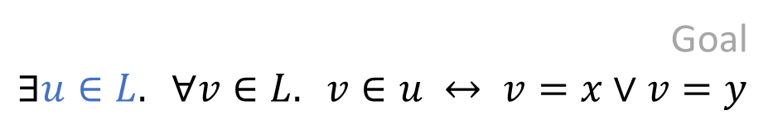
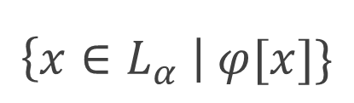
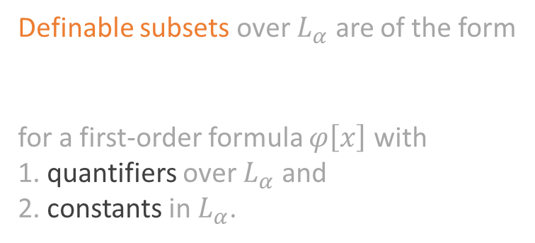
1. $\left(L, ∈\right)$ is a model of ZF – Pairing
Fix $x,y∈L$.
Goal
$$∃u∈L. ∀v∈L. v∈u ↔ v=x∨v=y$$
Pick a stage $L_{α}$ that contains both $x$ and $y$.
$$u≔\left\{v∈L_{α} ∣ v=x∨v=y\right\} ∈ L_{α+1}⊆L$$
Definable subsets over $L_{α}$ are of the form
for a first-order formula $φ\left[x\right]$ with
1. quantifiers over $L_{α}$ and
2. constants in $L_{α}$.
$$\left\{x∈L_{α} \right| φ[x]\}$$

Slide 23
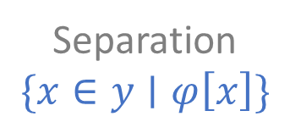
1. $\left(L, ∈\right)$ is a model of ZF
Power set
$$𝒫\left(x\right)$$
Extensionality
Empty set
$$∅$$
Pairing
$$\left\{x,y\right\}$$
Union
$$⋃x$$
Foundation
Infinity
$$ℕ$$
Replacement
$$\left\{f\left(x\right) ∣ x∈y\right\}$$
Separation
$$\{x∈y∣φ\left[x\right]\}$$
23

Slide 24
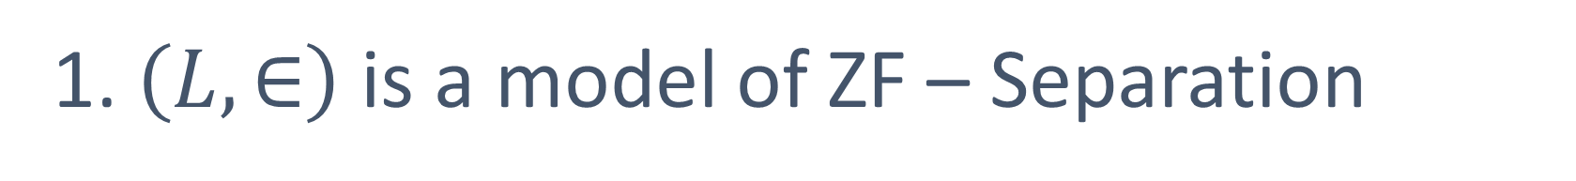
1. $\left(L, ∈\right)$ is a model of ZF – Separation

Slide 25
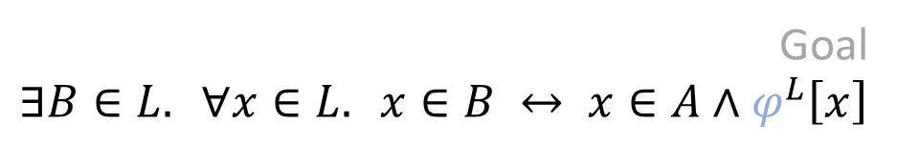

1. $\left(L, ∈\right)$ is a model of ZF – Separation
Fix $A∈L$ and
a formula $φ[x]$ over $L$.
Goal
$$∃B∈L. ∀x∈L. x∈B ↔ x∈A∧φ^{L}\left[x\right]$$

Slide 26
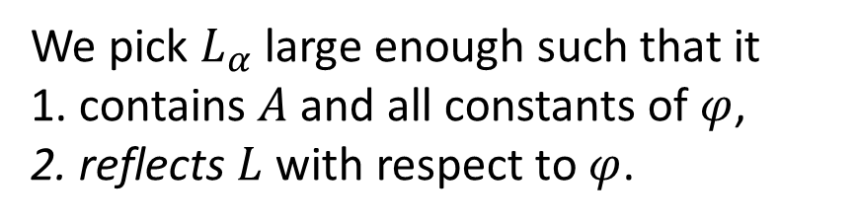
1. $\left(L, ∈\right)$ is a model of ZF – Separation
Fix $A∈L$ and
a formula $φ[x]$ over $L$.
Goal
$$∃B∈L. ∀x∈L. x∈B ↔ x∈A∧φ^{L}\left[x\right]$$
We pick $L_{α}$ large enough such that it
1. contains $A$ and all constants of $φ$,
2. reflects $L$ with respect to $φ$.
$$B≔\left\{x∈L_{α} | x∈A∧φ^{L_{α}}\left[x\right]\right\} ∈ L_{α+1}⊆L$$

Slide 27

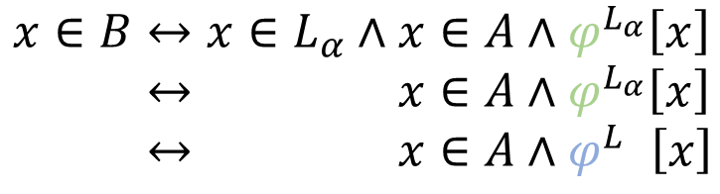
1. $\left(L, ∈\right)$ is a model of ZF – Separation
Fix $A∈L$ and
a formula $φ[x]$ over $L$.
Goal
$$∃B∈L. ∀x∈L. x∈B ↔ x∈A∧φ^{L}\left[x\right]$$
We pick $L_{α}$ large enough such that it
1. contains $A$ and all constants of $φ$,
2. reflects $L$ with respect to $φ$.
$$B≔\left\{x∈L_{α} | x∈A∧φ^{L_{α}}\left[x\right]\right\} ∈ L_{α+1}⊆L$$
$$x∈B↔x∈L_{α}∧x∈A∧φ^{L_{α}}\left[x\right] \\ ↔x∈L_{α}∧x∈A∧φ^{L_{α}}\left[x\right] \\ ↔x∈L_{α}∧x∈A∧φ^{L }\left[x\right]$$
$$A⊆L_{α}$$

Slide 28
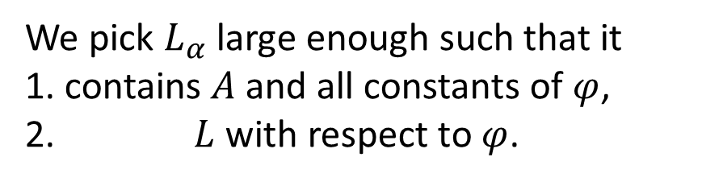
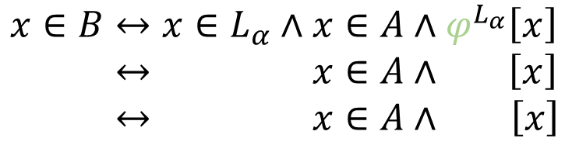
1. $\left(L, ∈\right)$ is a model of ZF – Separation
Fix $A∈L$ and
a formula $φ[x]$ over $L$.
Goal
$$∃B∈L. ∀x∈L. x∈B ↔ x∈A∧φ^{L}\left[x\right]$$
We pick $L_{α}$ large enough such that it
1. contains $A$ and all constants of $φ$,
2. reflects $L$ with respect to $φ$.
$$B≔\left\{x∈L_{α} | x∈A∧φ^{L_{α}}\left[x\right]\right\} ∈ L_{α+1}⊆L$$
$$x∈B↔x∈L_{α}∧x∈A∧φ^{L_{α}}\left[x\right] \\ ↔x∈L_{α}∧x∈A∧φ^{L_{α}}\left[x\right] \\ ↔x∈L_{α}∧x∈A∧φ^{L }\left[x\right]$$
$$A⊆L_{α}$$

Slide 29
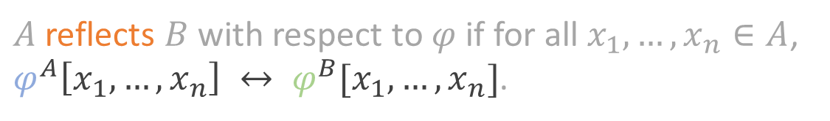

Reflection
Fix classes$A$and $B$
and a formula $φ[x_{1},…,x_{n}]$ with constants in $A$.
$A$ reflects $B$ with respect to $φ$ if for all $x_{1},…,x_{n}∈A$,
$φ^{A}\left[x_{1},…,x_{n}\right] ↔ φ^{B}[x_{1},…,x_{n}]$.
Example: $∅$ reflects $V$ with respect to the axiom of pairing
$$∀x,y∈∅.∃u∈∅. ∀v∈∅. v∈u↔v=x∨v=y.$$

Slide 30
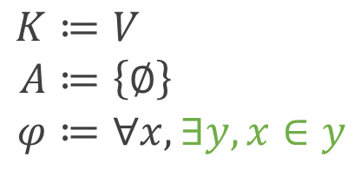
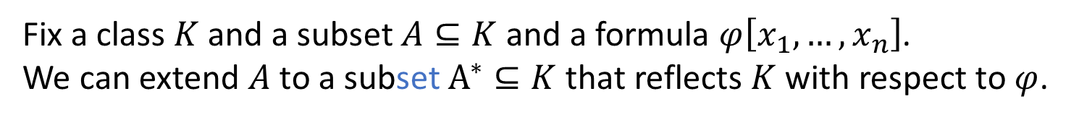
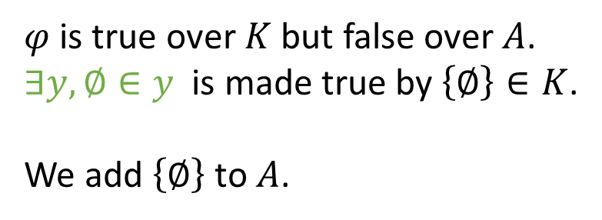
Reflection Theorem 1
[à la Tarski-Vaught]
Fix a class $K$ and a subset $A⊆K$ and a formula $φ\left[x_{1},…,x_{n}\right]$.
We can extend $A$ to a subset $A^{∗}⊆K$ that reflects $K$ with respect to $φ$.
Proof by example.
$$K≔V \\ A≔\left\{∅\right\} \\ φ≔∀x,∃y,x∈y$$
$φ$ is true over $K$ but false over $A$.
$∃y,∅∈y$ is made true by $\left\{∅\right\}∈K$.
We add $\left\{∅\right\}$ to $A$.

Slide 31
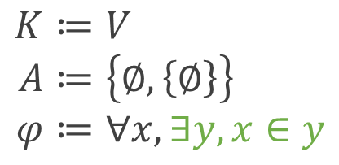
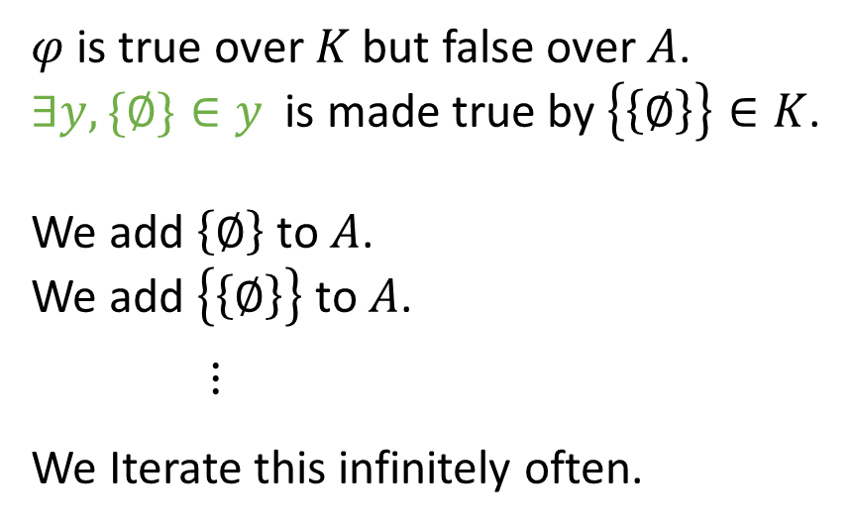
Reflection Theorem 1
[à la Tarski-Vaught]
Fix a class $K$ and a subset $A⊆K$ and a formula $φ\left[x_{1},…,x_{n}\right]$.
We can extend $A$ to a subset $A^{∗}⊆K$ that reflects $K$ with respect to $φ$.
Proof by example.
$$K≔V \\ A≔\left\{∅,\left\{∅\right\}\right\} \\ φ≔∀x,∃y,x∈y$$
$φ$ is true over $K$ but false over $A$.
$∃y,\{∅\}∈y$ is made true by $\left\{\left\{∅\right\}\right\}∈K$.
We add $\left\{∅\right\}$ to $A$.
We add $\left\{\left\{∅\right\}\right\}$ to $A$.
$⋮$
We Iterate this infinitely often.

Slide 32
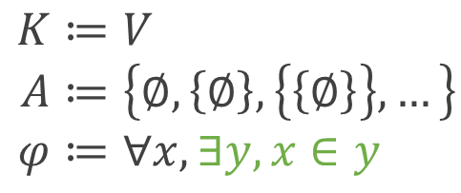
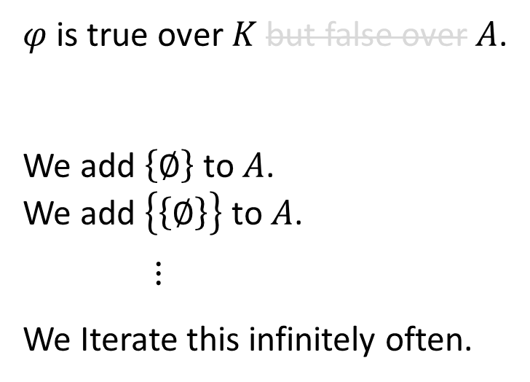
Reflection Theorem 1
[à la Tarski-Vaught]
Fix a class $K$ and a subset $A⊆K$ and a formula $φ\left[x_{1},…,x_{n}\right]$.
We can extend $A$ to a subset $A^{∗}⊆K$ that reflects $K$ with respect to $φ$.
Proof by example.
and over
$$K≔V \\ A≔\left\{∅,\left\{∅\right\},\left\{\left\{∅\right\}\right\},…\right\} \\ φ≔∀x,∃y,x∈y$$
$φ$ is true over $K$ but false over $A$.
We add $\left\{∅\right\}$ to $A$.
We add $\left\{\left\{∅\right\}\right\}$ to $A$.
$⋮$
We Iterate this infinitely often.

Slide 33

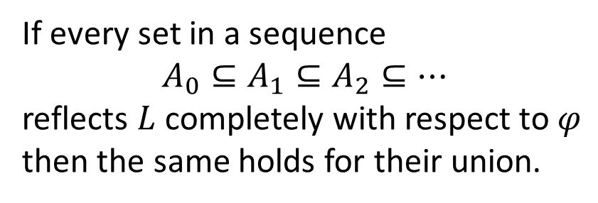
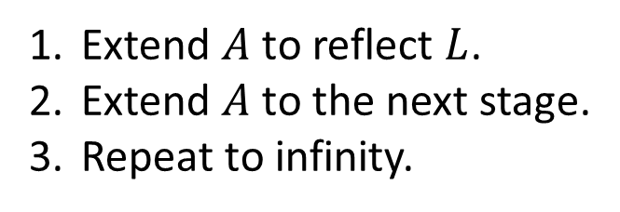









Reflection Theorem 2
[à la Montague-Levy]
Fix a subset $A⊆L$ and a formula $φ\left[x_{1},…,x_{n}\right]$.
We can extend $A$ to a stage $L_{α}$ that reflects $L$ with respect to $φ$.
Proof sketch.
$$L_{α}$$
$$⋮$$
Extend $A$ to reflect $L$.
Extend $A$ to the next stage.
Repeat to infinity.
$$L_{α_{3}}$$
$$L_{α_{2}}^{∗}$$
$$L_{α_{2}}$$
$$L_{α_{1}}^{∗}$$
If every set in a sequence
$$A_{0}⊆A_{1}⊆A_{2}⊆⋯$$
reflects $L$ completely with respect to $φ$
then the same holds for their union.
$$L_{α_{1}}$$
$$A^{∗}$$
$$A$$

Slide 34
Proof of Consistency (Outline)
[Smullyan and Fitting]
We work inside set theory.
0. We define a class $L$.
1. $\left(L, ∈\right)$ is a model of ZF.
2. $L$ satisfies $V=L$.
3. We can well-order $L$.
4. $L$ satisfies the well-ordering theorem.

Slide 35



2. $L$ satisfies $V=L$
$$\left(∀x,x∈L\right)$$
$$x∈L↔{\left(x∈L\right)}^{L}$$

Slide 36
Proof of Consistency (Outline)
[Smullyan and Fitting]
We work inside set theory.
0. We define a class $L$.
1. $\left(L, ∈\right)$ is a model of ZF.
2. $L$ satisfies $V=L$.
3. We can well-order $L$.
4. $L$ satisfies the well-ordering theorem.

Slide 37


3. We can well-order $L$
We well-order the elements of $L$ lexicographically by
their stage and
the formula that defines them

Slide 38
Proof of Consistency (Outline)
[Smullyan and Fitting]
We work inside set theory.
0. We define a class $L$.
1. $\left(L, ∈\right)$ is a model of ZF.
2. $L$ satisfies $V=L$.
3. We can well-order $L$.
4. $L$ satisfies the well-ordering theorem.

Slide 39
Formalisation in Coq
Axioms
excluded middle
definite description

Slide 40




Working in First-Order Logic
$$𝕋 ∷= x ∣ c \\ 𝔽 ∷= ∃F ∣ F∧F ∣ ¬F ∣ t=t ∣ t∈t$$
$$x∈ℕ \\ c is a set$$
(De Bruijn notation)
Possible Solutions
1. Superficial syntactic sugar
2. More complex syntax with
  named variables,
  function application and
  maybe more?
3. Automated reification of Coq terms
Example
$$𝒫\left(A\right)⊆A$$
$$∃B.\left(∀C.C∈B↔C⊆A\right)∧B⊆A$$
$$∃\left(∀0∈1↔0⊆2\right)∧0⊆1$$

Slide 41



Automated reification of Coq terms
$$Class Definability_On \left(A : Type\right)≔\{$$
$$Is_Definable′ \left(list 𝒮→A\right)→Prop \\ \}.$$
$$Existing Class Is_Definable′. \\ Notation Is_Definable x≔Is_Definable^{′}\left(const x\right).$$
Instances
Definability_On Prop
Definability_On $𝒮$
$$\frac{\begin{matrix}Definability_On \left(A\right) & Definability_On (B)\end{matrix}}{Definability_On \left(A → B\right)}$$

Slide 42






Encodings of Types
$$Class Encoding_Of \left(A :Type\right)≔\{ \\ encoding_class :Class;$$
$$encode :A≃encoding_class \\ \}.$$
Instances
$$Encoding_Of ℕ$$
$$Encoding_Of 𝔽$$
$$\frac{Encoding_Of A}{Definability_On A}$$
Definability_On $ℕ$
Definability_On $𝔽$
We can reuse definitions and lemmas on $ℕ$ and $𝔽$.

Slide 43





Conclusion
0. We define a class $L$.
1. $\left(L, ∈\right)$ is a model of ZF.
2. $L$ satisfies $V=L$.
3. We can well-order $L$.
4. $L$ satisfies the well-ordering theorem.
Current state: work-in-progress formalization of basic first-order set theory
Next steps: formalisation of 1, maybe 2, 3 and 4
Optional: Sierpiński‘s theorem from last talk in HoTT

Slide 44
References
Raymond M. Smullyan and Melvin Fitting
Set Theory and the Continuum Problem
Dover Publications, 2010.
Kurt Gödel.
The Consistency of the Axiom of Choice and of the Generalized Continuum-Hypothesis.
Proceedings of the National Academy of Sciences of the United States of America vol. 24, 1938

Slide 45


Reflection Theorem 1 (Details)
[à la Tarski-Vaught]
Fix a class $K$ and a subset $A⊆K$ and a formula $φ\left[x_{1},…,x_{n}\right]$.
We can extend $A$ to a subset $B⊆K$ that completely reflects $φ$.
$$A_{0}≔A \\ A_{n+1}≔A_{n+1}∪\bigcup_{ψ≺φ}{some sets that satisfy ψ over K} \\ A_{ℕ}≔\bigcup_{n∈ℕ}{A_{n}}$$

