Slide 1
Final Master Talk
Mechanising Set Theory in Coq
The Generalised Continuum Hypothesis and the Axiom of Choice
Felix Rech
Advisor: Dominik Kirst
June 26, 2020

Slide 2

Project Overview
Sierpinski’s theorem (in ${ZF}_{2}$)
Reification in first-order logic
Relative consistency of the axiom of choice (in $ZF′$)

Slide 3

Global Assumptions
Law of excluded middle
$$P∨¬P$$
Definite description
$$\left(∃!x.P\left(x\right)\right)→\sum_{x}{P(x)}$$
Function extensionality
$$\left(∀x,f\left(x\right)=g\left(x\right)\right)→(f=g)$$
Proposition extensionality
$$(P↔Q)→(P=Q)$$

Slide 4








The Set Theory ZF₂
[Kirst and Smolka 2017]
Fix $Set :Type$ and $∈ :Set→Set→Prop$.
Axioms
$$\left\{x,y\right\}$$
$$numerals$$
$$∅$$
extensionality
$$𝒫(A)$$
$$⋃A$$
$$\left\{x∈A ∣ P\left(x\right)\right\}$$
foundation
$$\left\{f\left(x\right) ∣ x∈A\right\}$$
$Set$ with $∈$ is a model of ${ZF}_{2}$ if they satisfy those axioms.

Slide 5

Encodings
An encoding of a type $A$ is a class $B$ with a bijection $A\underset{→}{∼}B$.
Examples
$ℕ$
$List( _ )$
In Replacement
$\left\{_ ∣ n :ℕ\right\}$

Slide 6





Generalised Continuum Hypothesis
$A$ infinite
$$A≤B≤𝒫(A)$$
$$A∼B$$
$$∨$$
$$B∼𝒫(A)$$

Slide 7
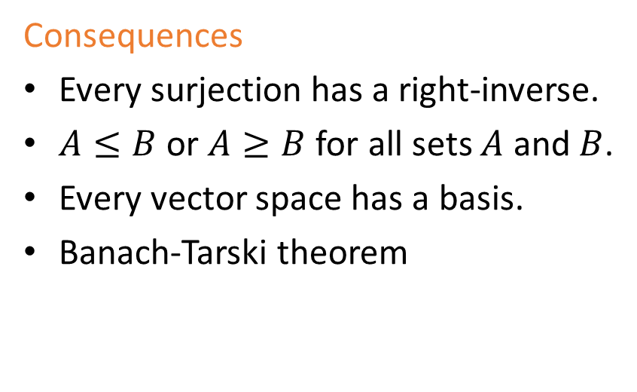
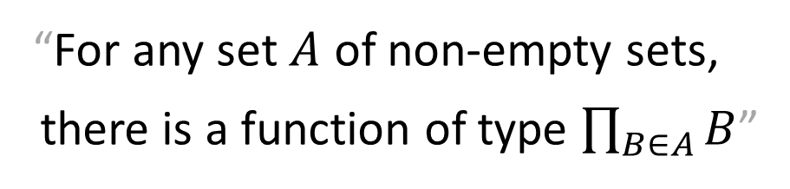
The Axiom of Choice
“For any set $A$ of non-empty sets,
there is a function of type $\prod_{B∈A}{B}$”
Consequences
Every surjection has a right-inverse.
$A≤B$ or $A≥B$ for all sets $A$ and $B$.
Every vector space has a basis.
Banach-Tarski theorem

Slide 8
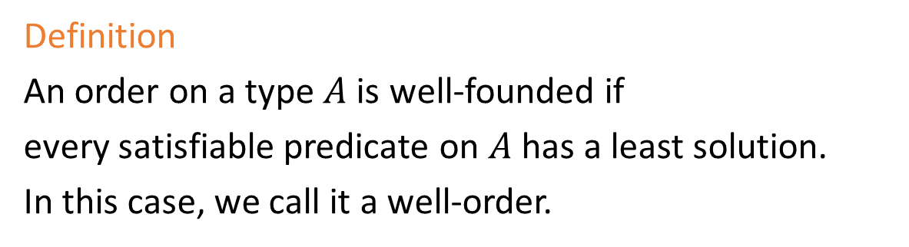
The Well-Ordering Theorem
“Every set has a well-ordering”
Definition
An order on a type $A$ is well-founded if
every satisfiable predicate on $A$ has a least solution.
In this case, we call it a well-order.

Slide 9
generalised continuum hypothesis
Sierpinski’s theorem
well-ordering theorem
axiom of
choice

Slide 10
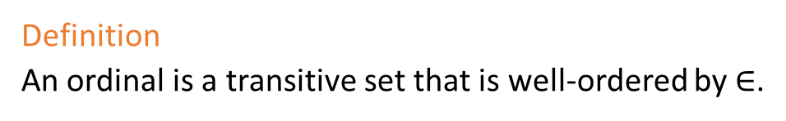
Ordinals – Canonical Well-Ordered Sets
Definition
An ordinal is a transitive set that is well-ordered by $∈$.
Every well-ordered set has exactly one order-isomorphic ordinal.

Slide 11
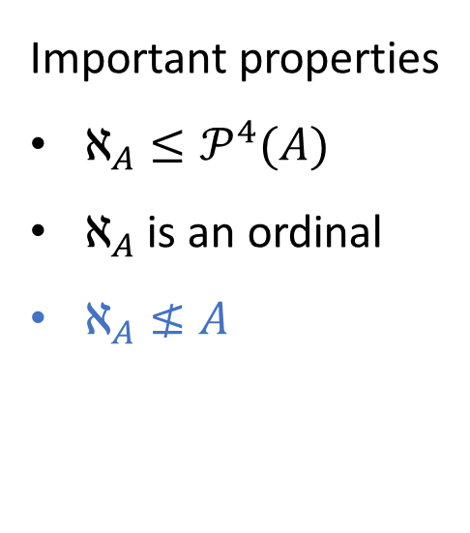

The Hartogs Number [1915]
A big ordinal
$$ℵ_{A}≔\left\{ α∈Ord | α≤A\right\}$$
Important properties
$ℵ_{A}≤𝒫^{4}(A)$
$ℵ_{A}$ is an ordinal
$ℵ_{A}≰A$

Slide 12
Sierpiński‘s Theorem [1947]
Generalized continuum hypothesis $→$ Axiom of choice

Slide 13
Sierpiński‘s Theorem [1947]
Generalized continuum hypothesis $→$ Well-ordering theorem $→$ Axiom of choice

Slide 14
Sierpiński‘s Theorem [1947]
Generalized continuum hypothesis $→$ Well-ordering theorem $→$ Axiom of choice

Slide 15



Sierpiński‘s Theorem [1947]
Generalized continuum hypothesis $→$ Well-ordering theorem $→$ Axiom of choice
Fix a set $A$ (w.l.o.g. large enough).
We show $A≤ℵ_{A}$.
$$ℵ_{A}≤𝒫^{4}(A)$$

Slide 16



Sierpiński‘s Theorem [1947]
Generalized continuum hypothesis $→$ Well-ordering theorem $→$ Axiom of choice
Fix a set $A$ (w.l.o.g. large enough).
We show $A≤ℵ_{A}$.
$$ℵ_{A}≤𝒫^{4}(A)$$
$$𝒫^{3}(A)$$
$$ℵ_{A}$$
$$𝒫^{4}(A)$$

Slide 17




Sierpiński‘s Theorem [1947]
Generalized continuum hypothesis $→$ Well-ordering theorem $→$ Axiom of choice
Fix a set $A$ (w.l.o.g. large enough).
We show $A≤ℵ_{A}$.
$$ℵ_{A}≤𝒫^{4}(A)$$
$$𝒫^{3}(A)$$
$$≤$$
$$𝒫^{3}\left(A\right)+ℵ_{A}$$
$$≤$$
$$𝒫^{4}(A)$$

Slide 18


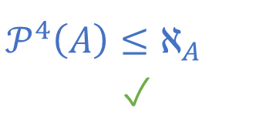


Sierpiński‘s Theorem [1947]
Generalized continuum hypothesis $→$ Well-ordering theorem $→$ Axiom of choice
Fix a set $A$ (w.l.o.g. large enough).
We show $A≤ℵ_{A}$.
$$ℵ_{A}≤𝒫^{4}(A)$$
$$𝒫^{4}\left(A\right)≤ℵ_{A}$$
✓
$$𝒫^{3}(A)$$
$$<$$
$$𝒫^{3}\left(A\right)+ℵ_{A}$$
$$∼$$
$$𝒫^{4}(A)$$

Slide 19


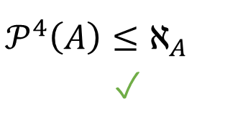


Sierpiński‘s Theorem [1947]
Generalized continuum hypothesis $→$ Well-ordering theorem $→$ Axiom of choice
Fix a set $A$ (w.l.o.g. large enough).
We show $A≤ℵ_{A}$.
$$ℵ_{A}≤𝒫^{4}(A)$$
$$𝒫^{4}\left(A\right)≤ℵ_{A}$$
✓
$$𝒫^{3}(A)$$
$$∼$$
$$𝒫^{3}\left(A\right)+ℵ_{A}$$
$$<$$
$$𝒫^{4}(A)$$

Slide 20



Sierpiński‘s Theorem [1947]
Generalized continuum hypothesis $→$ Well-ordering theorem $→$ Axiom of choice
Fix a set $A$ (w.l.o.g. large enough).
We show $A≤ℵ_{A}$.
$$ℵ_{A}≤𝒫^{4}(A)$$
$$ℵ_{A}≤𝒫^{3}(A)$$
$$𝒫^{4}\left(A\right)≤ℵ_{A}$$
✓
$$𝒫^{3}(A)$$
$$≥$$
$$𝒫^{3}\left(A\right)+ℵ_{A}$$
$$<$$
$$𝒫^{4}(A)$$

Slide 21





Sierpiński‘s Theorem [1947]
Generalized continuum hypothesis $→$ Well-ordering theorem $→$ Axiom of choice
Fix a set $A$ (w.l.o.g. large enough).
We show $A≤ℵ_{A}$.
$$ℵ_{A}≤𝒫^{4}(A)$$
$$ℵ_{A}≤𝒫^{3}(A)$$
$$𝒫^{4}\left(A\right)≤ℵ_{A}$$
✓
$$𝒫^{2}(A)$$
$$≤$$
$$𝒫^{2}\left(A\right)+ℵ_{A}$$
$$≤$$
$$𝒫^{3}(A)$$

Slide 22
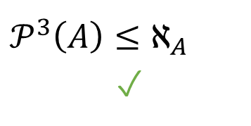





Sierpiński‘s Theorem [1947]
Generalized continuum hypothesis $→$ Well-ordering theorem $→$ Axiom of choice
Fix a set $A$ (w.l.o.g. large enough).
We show $A≤ℵ_{A}$.
$$ℵ_{A}≤𝒫^{4}(A)$$
$$ℵ_{A}≤𝒫^{3}(A)$$
$$𝒫^{4}\left(A\right)≤ℵ_{A}$$
✓
$$𝒫^{3}\left(A\right)≤ℵ_{A}$$
✓
$$𝒫^{2}(A)$$
$$<$$
$$𝒫^{2}\left(A\right)+ℵ_{A}$$
$$∼$$
$$𝒫^{3}(A)$$

Slide 23






Sierpiński‘s Theorem [1947]
Generalized continuum hypothesis $→$ Well-ordering theorem $→$ Axiom of choice
Fix a set $A$ (w.l.o.g. large enough).
We show $A≤ℵ_{A}$.
$$ℵ_{A}≤𝒫^{4}(A)$$
$$ℵ_{A}≤𝒫^{3}(A)$$
$$𝒫^{4}\left(A\right)≤ℵ_{A}$$
✓
$$ℵ_{A}≤𝒫^{2}(A)$$
$$𝒫^{3}\left(A\right)≤ℵ_{A}$$
✓
$$𝒫^{2}(A)$$
$$∼$$
$$𝒫^{2}\left(A\right)+ℵ_{A}$$
$$<$$
$$𝒫^{3}(A)$$

Slide 24

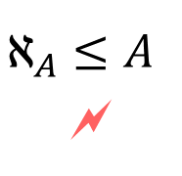


Sierpiński‘s Theorem [1947]
Generalized continuum hypothesis $→$ Well-ordering theorem $→$ Axiom of choice
Fix a set $A$ (w.l.o.g. large enough).
We show $A≤ℵ_{A}$.
$$ℵ_{A}≤𝒫^{4}(A)$$
$$ℵ_{A}≤𝒫^{3}(A)$$
$$𝒫^{4}\left(A\right)≤ℵ_{A}$$
✓
$$ℵ_{A}≤𝒫^{2}(A)$$
$$𝒫^{3}\left(A\right)≤ℵ_{A}$$
✓
$$ℵ_{A}≤𝒫(A)$$
$$𝒫^{2}\left(A\right)≤ℵ_{A}$$
✓
$$ℵ_{A}≤A$$
🗲
$$𝒫\left(A\right)≤ℵ_{A}$$
✓

Slide 25
The Set Theory ZF₂
Fix $Set :Type$ and $∈ :Set→Set→Prop$.
Axioms
$$\left\{x,y\right\}$$
$$numerals$$
$$∅$$
extensionality
$$𝒫(A)$$
$$⋃A$$
$$\left\{x∈A ∣ P\left(x\right)\right\}$$
foundation
$$\left\{f\left(x\right) ∣ x∈A\right\}$$
$Set$ with $∈$ is a model of ${ZF}_{2}$ if they satisfy those axioms.

Slide 26

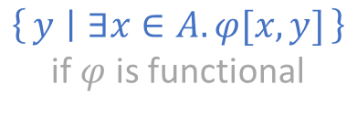
The Set Theory ZF’
Fix $Set :Type$ and $∈ :Set→Set→Prop$.
Axioms
$$\left\{x,y\right\}$$
$$numerals$$
$$∅$$
extensionality
$$𝒫(A)$$
$$⋃A$$
$$\left\{x∈A ∣ φ(x)\right\}$$
foundation
$$\left\{y ∣ ∃x∈A. φ[x,y]\right\}$$
if $φ$ is functional
$Set$ with $∈$ is a model of ZF’ if they satisfy those axioms.

Slide 27
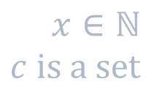

First-Order Logic
$$t ∷= x ∣ c \\ φ ∷= ∃φ ∣φ∧φ ∣ ¬φ ∣ t=t ∣ t∈t$$
$$x∈ℕ \\ c is a set$$
(De Bruijn notation)

Slide 28

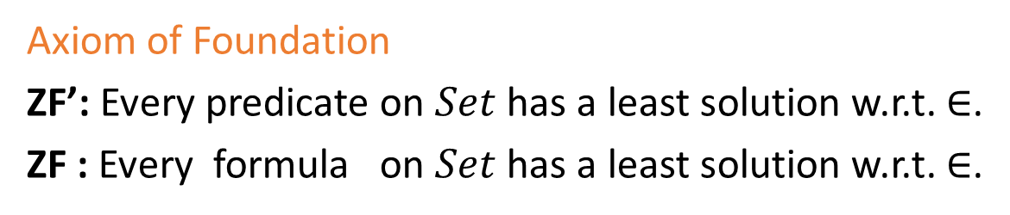
ZF’ and First-Order ZF
Axiom of Foundation
ZF’: Every predicate on $Set$ has a least solution w.r.t. $∈$.
ZF : Every formula on $Set$ has a least solution w.r.t. $∈$.
Given a model of ZF,
the well-founded fragment is a model of ZF’.
Every model of ZF’ is a model of ZF.
Both are equiconsistent.
But ZF’ has encodings of $ℕ$, Formula, …

Slide 29











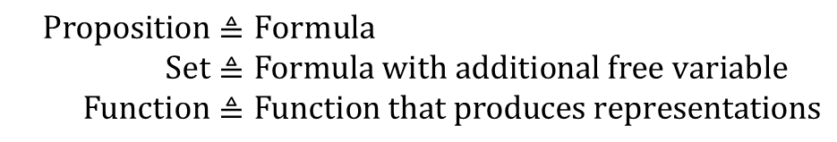
Reification in first-order logic
Assume we need the set $\left\{A∈B ∣ ∃x∈A.x≠∅\right\}$.
$${\left(∃x∈𝒫(A).x≠∅\right)}_{A}$$
$${\left(x∈𝒫(A)\right)}_{A,x}$$
$${\left(x≠∅\right)}_{A,x}$$
$${\left(x\right)}_{A,x}$$
$${\left(∈\right)}_{A,x}$$
$${\left(𝒫(A)\right)}_{A,x}$$
$${\left(x\right)}_{A,x}$$
$${\left(≠\right)}_{A,x}$$
$${\left(∅\right)}_{A,x}$$
$${\left(𝒫\right)}_{A,x}$$
$${\left(A\right)}_{A,x}$$
$$Proposition≜Formula \\ Set≜Formula with additional free variable \\ Function≜Function that produces representations$$

Slide 30
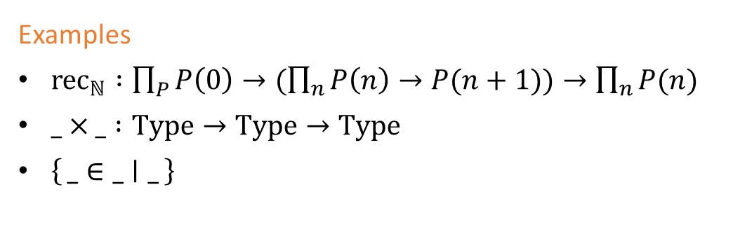

What we can represent
Dependent functions
Propositions (with quantification over types)
Sets
Classes
Elements of types with encoding
Pairs
Types
$⋮$
Examples
${rec}_{ℕ} :\prod_{P}{P\left(0\right)→(\prod_{n}{P\left(n\right)→P(n+1))→\prod_{n}{P(n)}}}$
$_×_ :Type→Type→Type$
$\left\{_∈_ ∣ _\right\}$

Slide 31
Representations
A local representation of a family of dependent functions (fγ : Πx:AγBγ(x))γ:Γ is a function that takes a full representation of any family (xγ : Aγ)γ:Γ and returns a local representation of (fγ(xγ))γ:Γ.
A local representation of a family of propositions (Pγ : P)γ:Γ is a formula ϕ with n free variables, such that (γ ϕ) ⇔ Pγ for all environments γ : Γ.

Slide 32
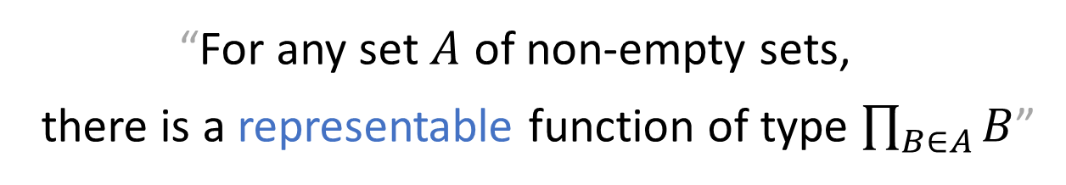
The Axiom of Choice (In ZF’)
“For any set $A$ of non-empty sets,
there is a representable function of type $\prod_{B∈A}{B}$”

Slide 33
The Well-Ordering Theorem (In ZF’)
“Every set has a representable well-ordering”

Slide 34
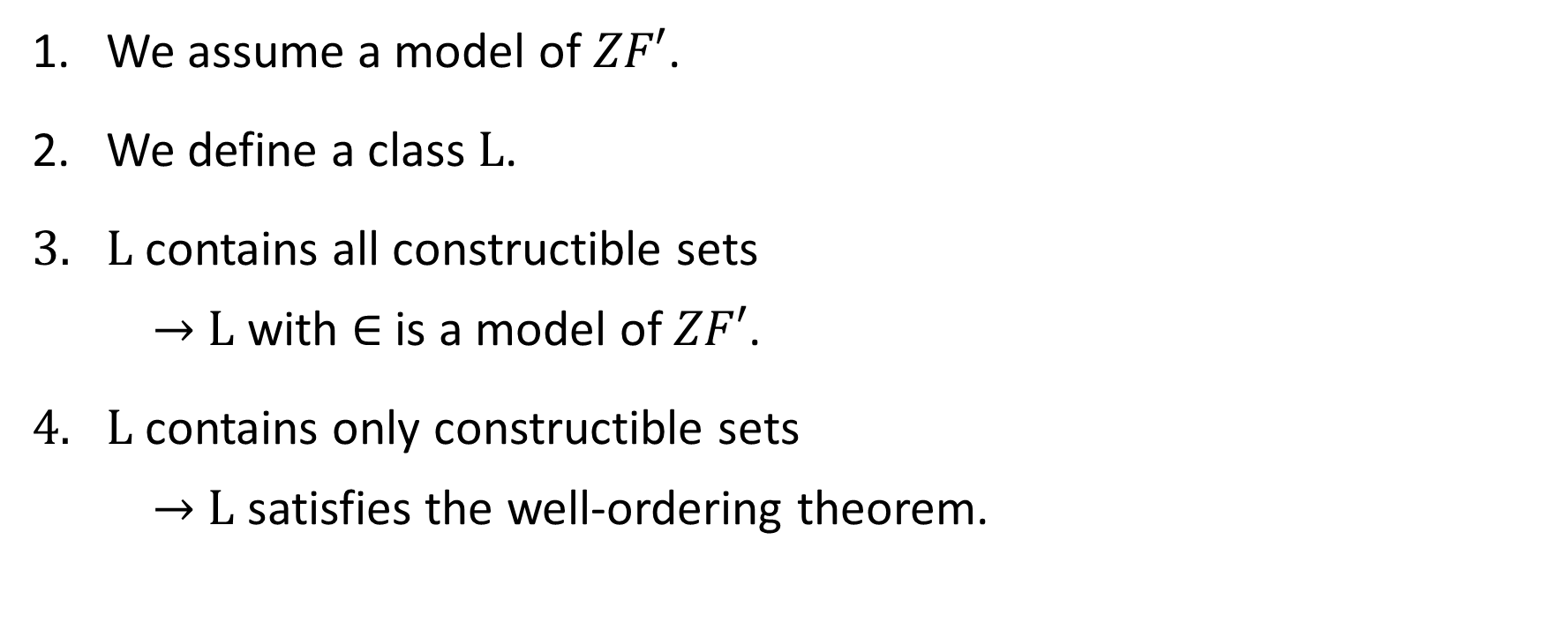
Relative consistency of the axiom of choice
[Gödel 1938]
We assume a model of $ZF′$.
We define a class $L$.
$L$ contains all constructible sets
$→$ $L$ with $∈$ is a model of $ZF′$.
$L$ contains only constructible sets
$→$ $L$ satisfies the well-ordering theorem.

Slide 35
















Ordinals – Counting past infinity
$$⋯$$
$$3$$
$$ω+2$$
$$ω⋅2+1$$
$$ω⋅3$$
$$ω^{2}+2$$
$$2$$
$$ω+1$$
$$ω⋅2$$
$$ω^{2}+1$$
$$1$$
$$1$$
$$ω$$
$$ω^{2}$$
$$0$$
$$0$$
Every set of ordinals has an upper bound.

Slide 36











L – The Constructible Hierarchy
The Constructible Universe
$$L$$
$$⋮$$
$$⋮$$
$$L_{ω+2}$$
$$L_{ω+1}$$
$$L_{ω}$$
$$⋮$$
$$L_{3}$$
$$L_{2}$$
$$L_{1}$$
$$L_{0}$$
36

Slide 37


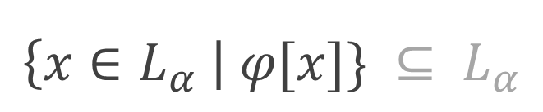
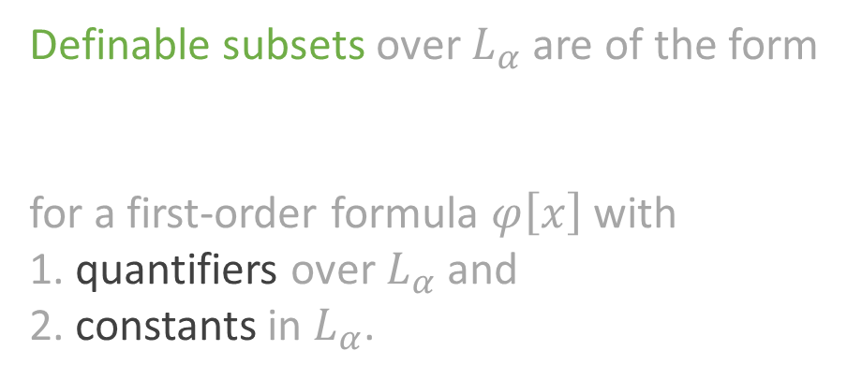
L – The Constructible Hierarchy
$$L_{0} ≔∅ \\ L_{α+1}≔definable subsets over L_{α} \\ L_{λ} ≔ \bigcup_{α<λ}{ L_{α}} \\ L ≔\bigcup_{α∈Ord}{L_{α}}$$
The Constructible Universe
$$L$$
$$⋮$$
$$⋮$$
$$L_{ω+2}$$
$$L_{ω+1}$$
$$L_{ω}$$
$$⋮$$
Definable subsets over $L_{α}$ are of the form
for a first-order formula $φ\left[x\right]$ with
1. quantifiers over $L_{α}$ and
2. constants in $L_{α}$.
$$L_{3}$$
$$\left\{x∈L_{α} \right| φ[x]\} ⊆ L_{α}$$
$$L_{2}$$
$$L_{1}$$
$$L_{0}$$
37

Slide 38
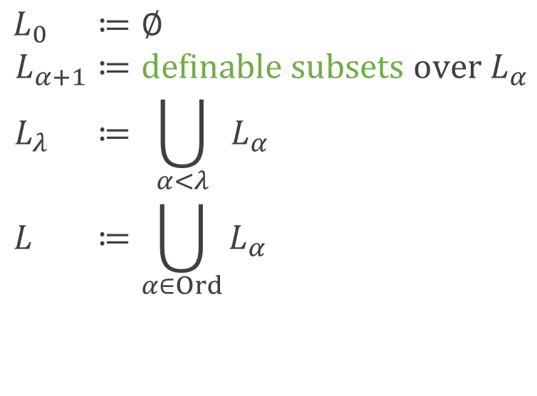
L – The Constructible Hierarchy
$$L_{0} ≔∅ \\ L_{α+1}≔definable subsets over L_{α} \\ L_{λ} ≔ \bigcup_{α<λ}{ L_{α}} \\ L ≔\bigcup_{α∈Ord}{L_{α}}$$
The Constructible Universe
$$L$$
$$⋮$$
$$⋮$$
$$L_{ω+2}$$
$$L_{ω+1}$$
$$L_{ω}$$
$$⋮$$
Definable subsets over $L_{α}$ are of the form
for a first-order formula $φ\left[x\right]$ with
1. quantifiers over $L_{α}$ and
2. constants in $L_{α}$.
$$L_{3}$$
$$\left\{x∈L_{α} \right| φ[x]\} ⊆ L_{α}$$
$$L_{2}$$
$$L_{1}$$
$$L_{0}$$
38

Slide 39
Coq Formalisation
Sierpinski’s theorem
2458 lines
The constructible hierarchy
Incomplete
Typeclasses for representations
1747 lines

Slide 40
Conclusion
ZF’ is a useful compromise between ZF₂ and first-order ZF.
Our notions of encodings and representations imitate informal practice.
Formalisation:
  Sierpinski’s theorem
  Consistency of the axiom of choice (incomplete)
Future work
Consistency of the generalised continuum hypothesis
Apply representations to other proofs and theories
Type-theoretic version of Sierpinski’s theorem
Improve representability
Thank you!

Slide 41
References
Dominik Kirst and Gert Smolka.
Categoricity results for second-order ZF in dependent type theory.
International Conference on Interactive Theorem Proving. Springer, Cham, 2017.
Friedrich Hartogs.
Über das Problem der Wohlordnung.
Mathematische Annalen 76.4 (1915): 438-443.
Wacław Sierpiński.
L'hypothèse généralisée du continu et l'axiome du choix.
Fundamenta Mathematicae 1.34 (1947): 1-5.

Slide 42
References 2
Raymond M. Smullyan and Melvin Fitting
Set Theory and the Continuum Problem
Dover Publications, 2010.
Kurt Gödel.
The Consistency of the Axiom of Choice and of the Generalized Continuum-Hypothesis.
Proceedings of the National Academy of Sciences of the United States of America vol. 24, 1938

