Slide 1
First Master Seminar Talk
Sierpiński‘s Theorem
The generalized continuum hypothesis implies the axiom of choice
Felix Rech
Advisor: Dominik Kirst
June 14, 2019

Slide 2
Second-Order
Zermelo-Fraenkel Set Theory
[Kirst and Smolka 2017]
Assume a type $Set$ and a relation $_∈_ :Set→Set→Prop$.
Extensionality | Sets are equal if they have the same elements.
Empty Set | There is an empty set.
Foundation
Union | For a given set, we can build the union of all elements.
Power Set | Every set has a power set.
Infinity
Replacement | The image of a set under a functional relation is a set.
The element relation is well-founded.
The numerals form a set.

Slide 3

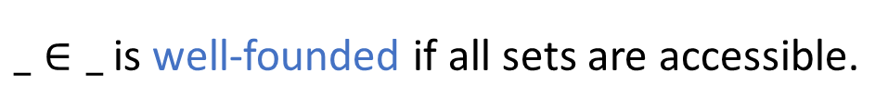
Second-Order
Zermelo-Fraenkel Set Theory
[Kirst and Smolka 2017]
Assume a type $Set$ and a relation $_∈_ :Set→Set→Prop$.
Extensionality | Sets are equal if they have the same elements.
Empty Set | There is an empty set.
Foundation
Union | For a given set, we can build the union of all elements.
Power Set | Every set has a power set.
Infinity
Replacement | The image of a set under a functional relation is a set.
The element relation is well-founded.
$$\frac{∀y∈x. accessible(y)}{accessible(x)}$$
$_∈_$ is well-founded if all sets are accessible.
The numerals form a set.

Slide 4
Second-Order
Zermelo-Fraenkel Set Theory
[Kirst and Smolka 2017]
Assume a type $Set$ and a relation $_∈_ :Set→Set→Prop$.
Extensionality | Sets are equal if they have the same elements.
Empty Set | There is an empty set.
Foundation
Union | For a given set, we can build the union of all elements.
Power Set | Every set has a power set.
Infinity
Replacement | The image of a set under a functional relation is a set.
The element relation is well-founded.
The numerals form a set.

Slide 5

Second-Order
Zermelo-Fraenkel Set Theory
[Kirst and Smolka 2017]
Assume a type $Set$ and a relation $_∈_ :Set→Set→Prop$.
Extensionality | Sets are equal if they have the same elements.
Empty Set | There is an empty set
Foundation
Union | For a given set, we can build the union of all elements.
Power Set | Every set has a power set.
Infinity
Replacement | The image of a set under a functional relation is a set.
The element relation is well-founded.
The numerals form a set.
Successor
$$σ\left(x\right)≔\left\{x\right\}∪x$$
Numerals
$$\overline{0}≔∅ \\ \overline{n+1}≔σ(\overline{n})$$
$$ℕ≔\left\{x | ∃n.x=\overline{n}\right\}$$
5

Slide 6

Second-Order
Zermelo-Fraenkel Set Theory
[Kirst and Smolka 2017]
Assume a type $Set$ and a relation $_∈_ :Set→Set→Prop$.
Extensionality | Sets are equal if they have the same elements.
Empty Set | There is an empty set.
Foundation
Union | For a given set, we can build the union of all elements.
Power Set | Every set has a power set.
Infinity
Replacement | The image of a set under a functional relation is a set.
The element relation is well-founded.
The numerals form a set.
$$Set→Set→Prop$$

Slide 7
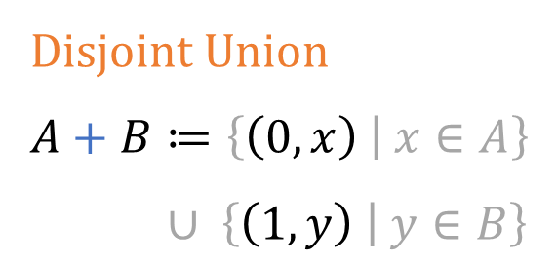
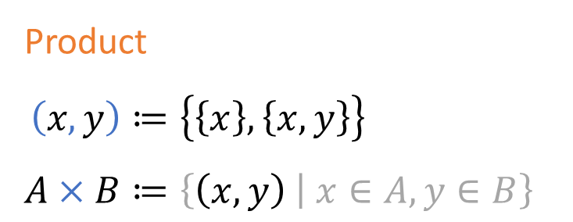
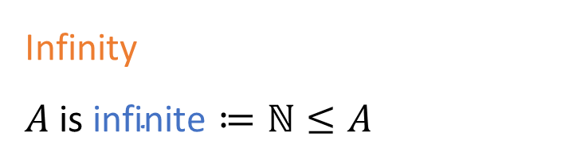
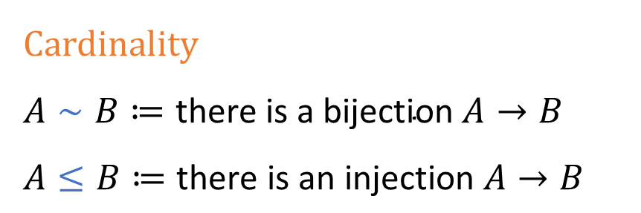
Notations
Product
$$\left(x,y\right)≔\left\{\left\{x\right\},\left\{x,y\right\}\right\} \\ A×B≔\left\{\left(x,y\right) | x∈A,y∈B\right\}$$
Cardinality
$$A∼B≔\text{there} \text{is} \text{a} \text{bijection} A→B \\ A≤B≔\text{there} \text{is} \text{an} \text{injection} A→B$$
Disjoint Union
$$A+B≔\left\{\left(0,x\right) | x∈A\right\}∪ \left\{\left(1,y\right) | y∈B\right\}$$
Infinity
$$A \text{is} \text{infinite}≔ℕ≤A$$

Slide 8


Axiom of Choice
Fix $I :Set$
and $F :I→Set$.
$$\frac{∀ i.F(i)}{∀ i.F\left(i\right)}$$

Slide 9
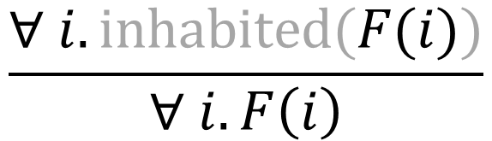
Axiom of Choice
Fix $I :Set$
and $F :I→Set$.
$$\frac{∀ i.\text{inhabited}(F(i))}{∀ i.F\left(i\right)}$$

Slide 10
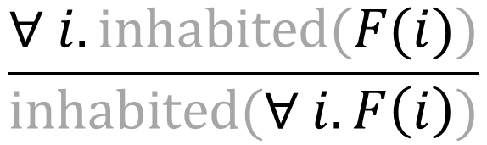
Axiom of Choice
Fix $I :Set$
and $F :I→Set$.
$$\frac{∀ i.\text{inhabited}\text{(}F(i))}{\text{inhabited}(∀ i.F\left(i\right))}$$

Slide 11

Consequences of the Axiom of Choice
Every surjection has a right inverse.
Every non-listable set $A$ satisfies $ℕ≤A$.
Every infinite set $A$ has a bijection $A→A×A$.
Linearity: $A≤B$ or $A≥B$ for all sets $A$ and $B$.

Slide 12




Continuum Hypothesis
$$ℕ≤B≤𝒫(ℕ)$$
$$ℕ∼B$$
$$∨$$
$$B∼𝒫(ℕ)$$

Slide 13



Generalized Continuum Hypothesis
A infinite
$$A≤B≤𝒫(A)$$
$$A∼B$$
$$∨$$
$$B∼𝒫(A)$$

Slide 14


Ordinals
Representatives for isomorphism classes of well-orders
Definition. A set $x$ is transitive if
$$z∈y → y∈x → z∈x.$$
We define the class $𝒪$ of ordinals inductively:
$$\frac{α is transitive ∀ y∈x. y∈𝒪}{α∈𝒪}$$
$$𝒪=\{ ∅, σ\left(∅\right), σ^{2}\left(∅\right), …, ℕ, σ\left(ℕ\right), … \}$$

Slide 15
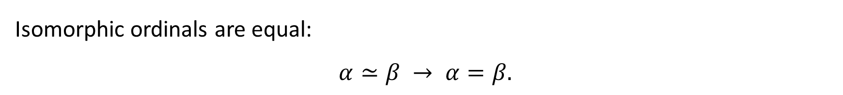
Ordinals are Representatives
Every ordinal is well-ordered by the $∈$-relation.
Isomorphic ordinals are equal:
$$α≃β → α=β.$$
Every well-ordered set has a unique isomorphic ordinal.

Slide 16

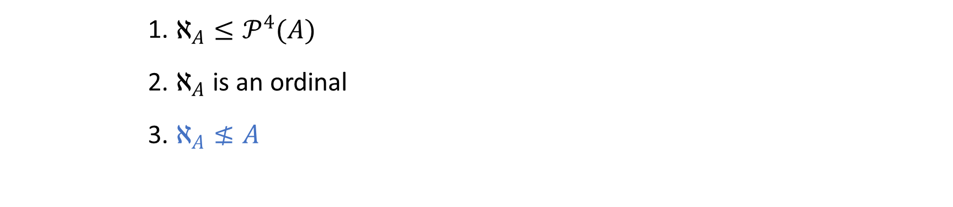
Hartogs Number [1915]
A big ordinal
$$ℵ_{A}≔\left\{ α∈𝒪 | α≤A\right\}$$
1. | $$ℵ_{A}≤𝒫^{4}(A)$$
2. | $ℵ_{A}$ is an ordinal
3. | $$ℵ_{A}≰A$$

Slide 17

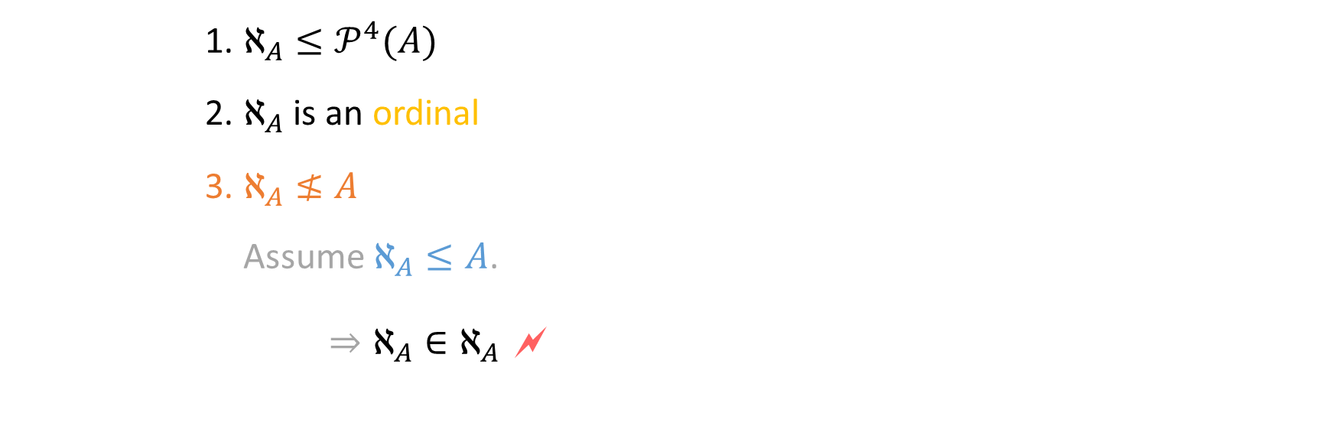
Hartogs Number [1915]
A big ordinal
$$ℵ_{A}≔\left\{ α∈𝒪 | α≤A\right\}$$
1. | $$ℵ_{A}≤𝒫^{4}(A)$$
2. | $ℵ_{A}$ is an ordinal
3. | $$ℵ_{A}≰A$$
 | Assume $ℵ_{A}≤A$. $⇒ℵ_{A}∈ℵ_{A}$ 🗲

Slide 18
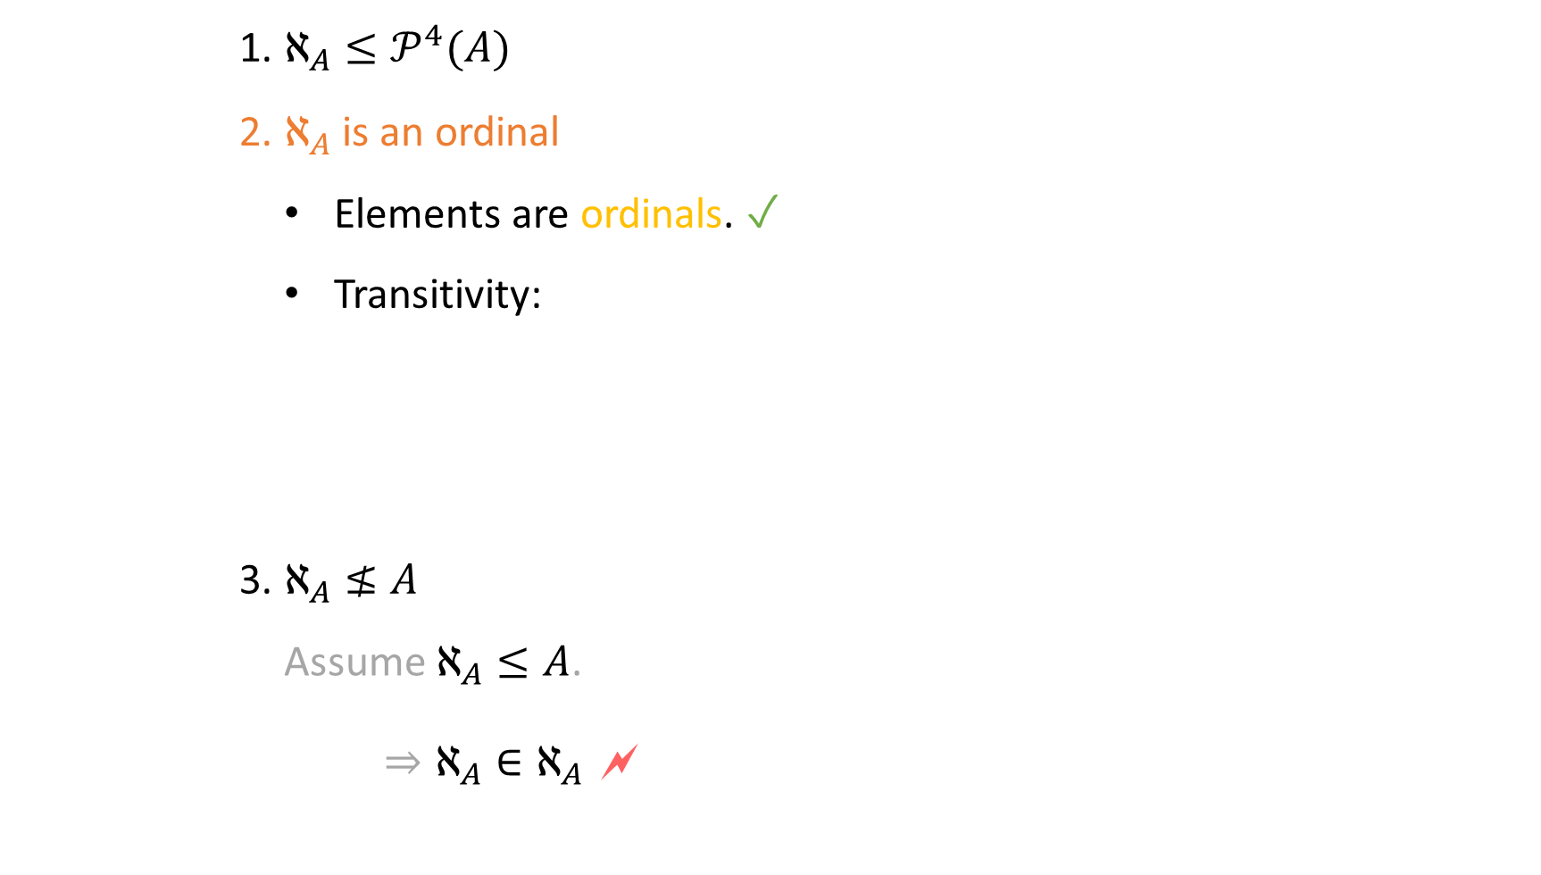
Hartogs Number [1915]
A big ordinal
$$ℵ_{A}≔\left\{ α∈𝒪 | α≤A\right\}$$
1. | $$ℵ_{A}≤𝒫^{4}(A)$$
2. | $ℵ_{A}$ is an ordinal
 | Elements are ordinals. ✓ Transitivity:
3. | $$ℵ_{A}≰A$$
 | Assume $ℵ_{A}≤A$. $⇒ℵ_{A}∈ℵ_{A}$ 🗲

Slide 19
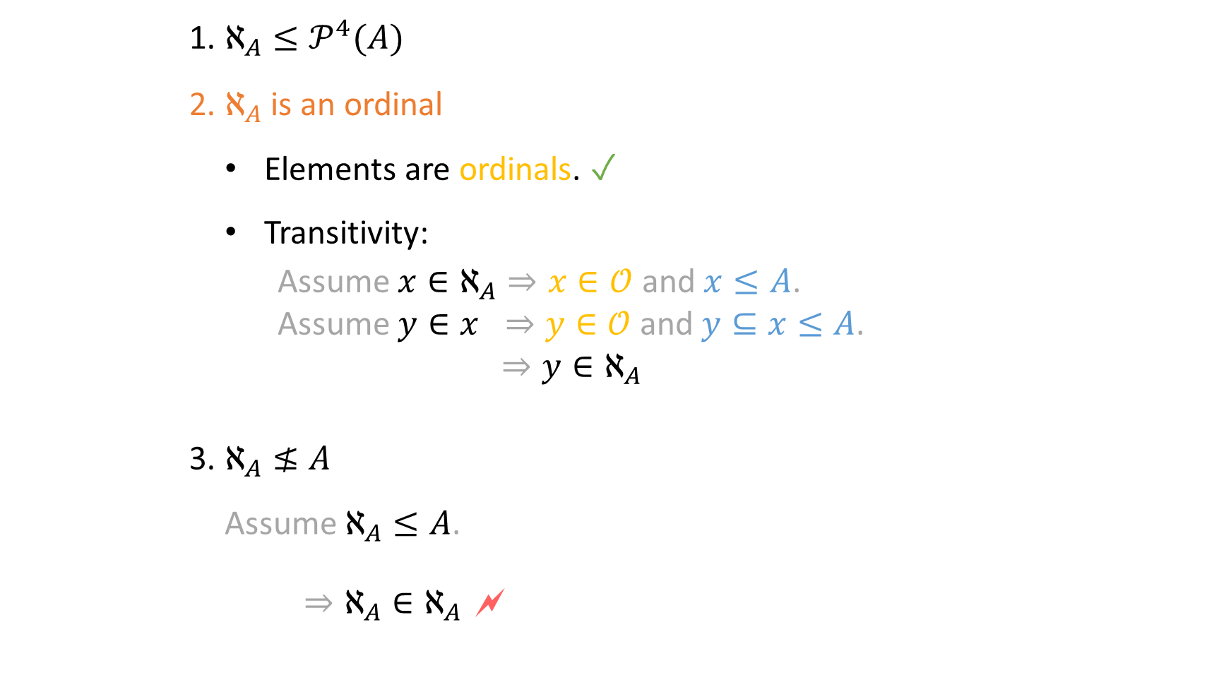
Hartogs Number [1915]
A big ordinal
$$ℵ_{A}≔\left\{ α∈𝒪 | α≤A\right\}$$
1. | $$ℵ_{A}≤𝒫^{4}(A)$$
2. | $ℵ_{A}$ is an ordinal
 | Elements are ordinals. ✓ Transitivity: Assume $x∈ℵ_{A}⇒x∈𝒪$ and $x≤A$. Assume $y∈x ⇒y∈𝒪$ and $y⊆x≤A$. $⇒y∈ℵ_{A}$
3. | $$ℵ_{A}≰A$$
 | Assume $ℵ_{A}≤A$. $⇒ℵ_{A}∈ℵ_{A}$ 🗲

Slide 20
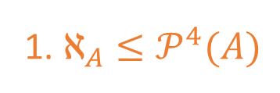
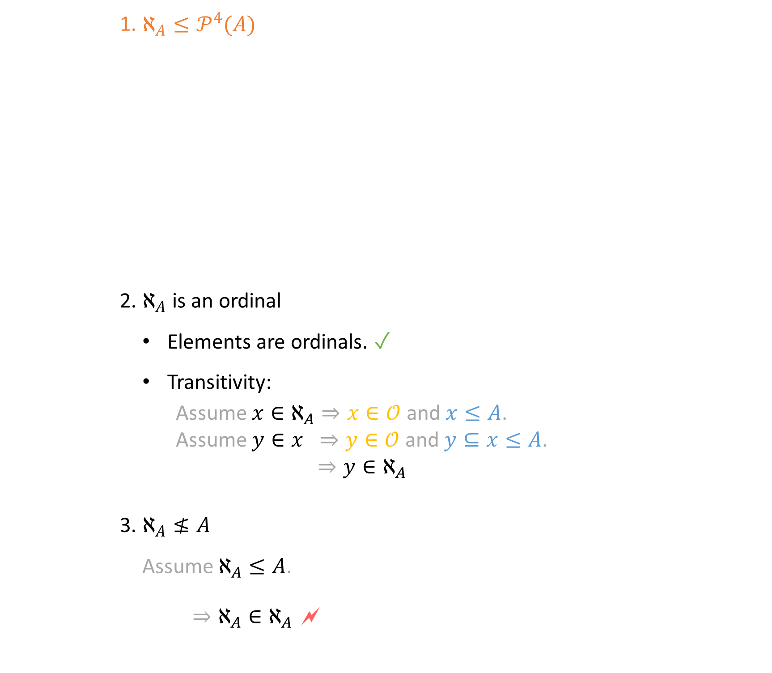
Hartogs Number [1915]
A big ordinal
$$ℵ_{A}≔\left\{ α∈𝒪 | α≤A\right\}$$
1. $ℵ_{A}≤𝒫^{4}(A)$
1. | $$ℵ_{A}≤𝒫^{4}(A)$$
2. | $ℵ_{A}$ is an ordinal
 | Elements are ordinals. ✓ Transitivity: Assume $x∈ℵ_{A}⇒x∈𝒪$ and $x≤A$. Assume $y∈x ⇒y∈𝒪$ and $y⊆x≤A$. $⇒y∈ℵ_{A}$
3. | $$ℵ_{A}≰A$$
 | Assume $ℵ_{A}≤A$. $⇒ℵ_{A}∈ℵ_{A}$ 🗲

Slide 21

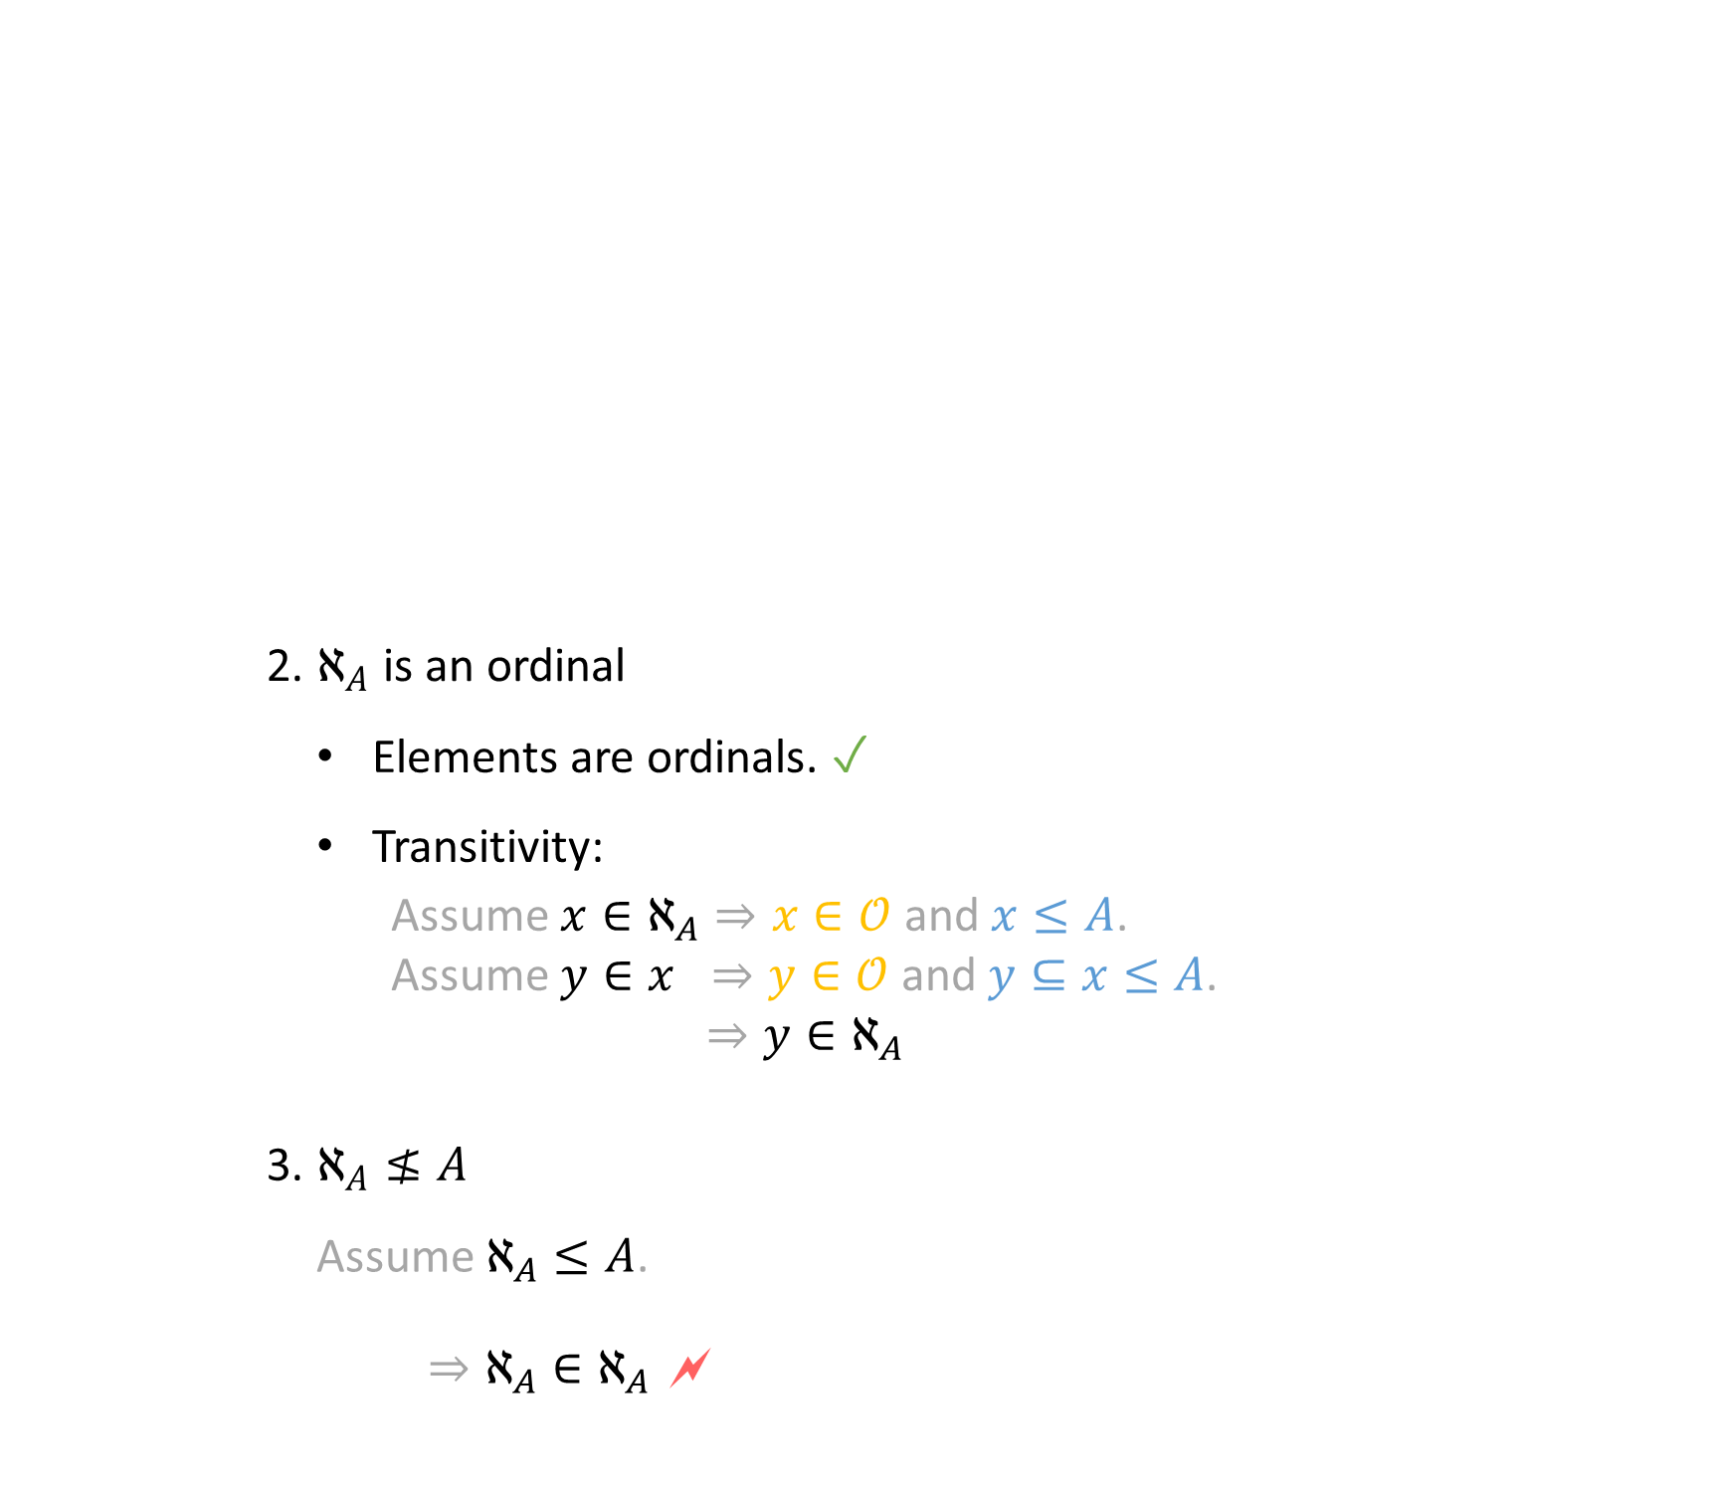
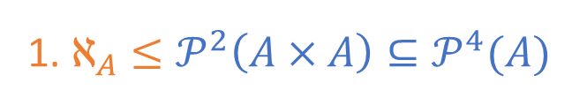
Hartogs Number [1915]
A big ordinal
$$ℵ_{A}≔\left\{ α∈𝒪 | α≤A\right\}$$
1. $ℵ_{A}≤𝒫^{2}\left(A×A\right)⊆𝒫^{4}(A)$
$\left(x,y\right)=\left\{\left\{x\right\},\left\{x,y\right\}\right\}$
$$⇒A×A⊆𝒫^{2}\left(A\right)$$
2. | $ℵ_{A}$ is an ordinal
 | Elements are ordinals. ✓ Transitivity: Assume $x∈ℵ_{A}⇒x∈𝒪$ and $x≤A$. Assume $y∈x ⇒y∈𝒪$ and $y⊆x≤A$. $⇒y∈ℵ_{A}$
3. | $$ℵ_{A}≰A$$
 | Assume $ℵ_{A}≤A$. $⇒ℵ_{A}∈ℵ_{A}$ 🗲

Slide 22
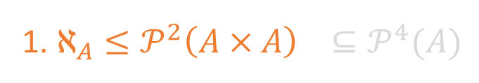

Hartogs Number [1915]
A big ordinal
$$ℵ_{A}≔\left\{ α∈𝒪 | α≤A\right\}$$
1. $ℵ_{A}≤𝒫^{2}\left(A×A\right) ⊆𝒫^{4}(A)$
$\left(x,y\right)=\left\{\left\{x\right\},\left\{x,y\right\}\right\}$
$$⇒A×A⊆𝒫^{2}\left(A\right)$$
2. | $ℵ_{A}$ is an ordinal
 | Elements are ordinals. ✓ Transitivity: Assume $x∈ℵ_{A}⇒x∈𝒪$ and $x≤A$. Assume $y∈x ⇒y∈𝒪$ and $y⊆x≤A$. $⇒y∈ℵ_{A}$
3. | $$ℵ_{A}≰A$$
 | Assume $ℵ_{A}≤A$. $⇒ℵ_{A}∈ℵ_{A}$ 🗲

Slide 23
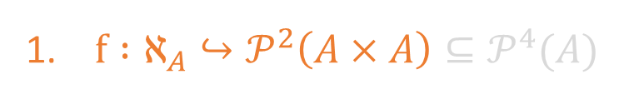

Hartogs Number [1915]
A big ordinal
$$ℵ_{A}≔\left\{ α∈𝒪 | α≤A\right\}$$
1. $f :ℵ_{A}↪𝒫^{2}\left(A×A\right)⊆𝒫^{4}(A)$
$\left(x,y\right)=\left\{\left\{x\right\},\left\{x,y\right\}\right\}$
$$⇒A×A⊆𝒫^{2}\left(A\right)$$
 | $$f\left(α\right)≔\left\{ x∈𝒫\left(A×A\right) | x≃α \right\}$$
2. | $ℵ_{A}$ is an ordinal
 | Elements are ordinals. ✓ Transitivity: Assume $x∈ℵ_{A}⇒x∈𝒪$ and $x≤A$. Assume $y∈x ⇒y∈𝒪$ and $y⊆x≤A$. $⇒y∈ℵ_{A}$
3. | $$ℵ_{A}≰A$$
 | Assume $ℵ_{A}≤A$. $⇒ℵ_{A}∈ℵ_{A}$ 🗲

Slide 24
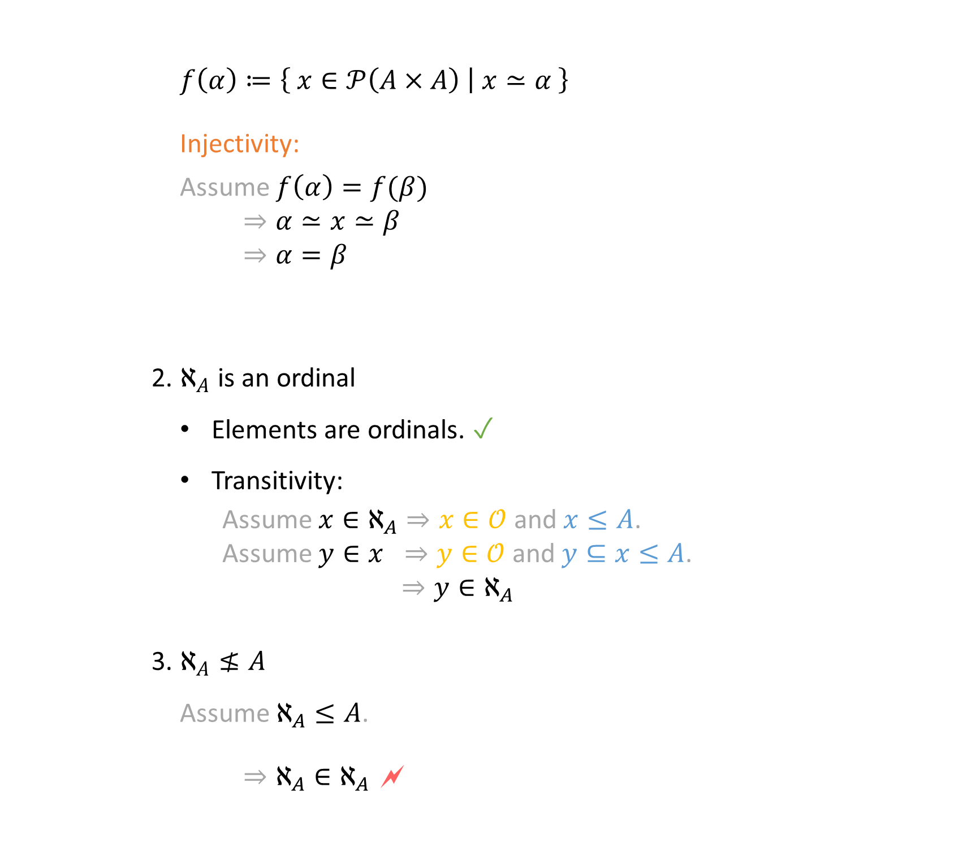
Hartogs Number [1915]
A big ordinal
$$ℵ_{A}≔\left\{ α∈𝒪 | α≤A\right\}$$
1. $f :ℵ_{A}↪𝒫^{2}\left(A×A\right)⊆𝒫^{4}(A)$
$\left(x,y\right)=\left\{\left\{x\right\},\left\{x,y\right\}\right\}$
$$⇒A×A⊆𝒫^{2}\left(A\right)$$
 | $$f\left(α\right)≔\left\{ x∈𝒫\left(A×A\right) | x≃α \right\}$$ Injectivity: Assume $f\left(α\right)=f(β)$ $⇒α≃x≃β$ $⇒α=β$
2. | $ℵ_{A}$ is an ordinal
 | Elements are ordinals. ✓ Transitivity: Assume $x∈ℵ_{A}⇒x∈𝒪$ and $x≤A$. Assume $y∈x ⇒y∈𝒪$ and $y⊆x≤A$. $⇒y∈ℵ_{A}$
3. | $$ℵ_{A}≰A$$
 | Assume $ℵ_{A}≤A$. $⇒ℵ_{A}∈ℵ_{A}$ 🗲

Slide 25

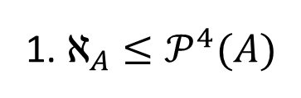
Hartogs Number [1915]
A big ordinal
$$ℵ_{A}≔\left\{ α∈𝒪 | α≤A\right\}$$
1. $ℵ_{A}≤𝒫^{4}(A)$
2. | $ℵ_{A}$ is an ordinal
3. | $$ℵ_{A}≰A$$

Slide 26
Sierpiński‘s Theorem [1947]
Generalized continuum hypothesis $→$ Axiom of choice

Slide 27
Sierpiński‘s Theorem [1947]
Generalized continuum hypothesis $→$ Well-ordering theorem $→$ Axiom of choice

Slide 28
Sierpiński‘s Theorem [1947]
Generalized continuum hypothesis $→$ Well-ordering theorem $→$ Axiom of choice

Slide 29


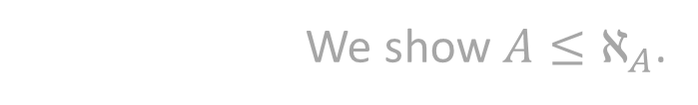
Sierpiński‘s Theorem [1947]
Generalized continuum hypothesis $→$ Well-ordering theorem $→$ Axiom of choice
Fix a set $A$ (w.l.o.g. large enough).
We show $A≤ℵ_{A}$.
$$ℵ_{A}≤𝒫^{4}(A)$$

Slide 30



Sierpiński‘s Theorem [1947]
Generalized continuum hypothesis $→$ Well-ordering theorem $→$ Axiom of choice
Fix a set $A$ (w.l.o.g. large enough).
We show $A≤ℵ_{A}$.
$$ℵ_{A}≤𝒫^{4}(A)$$
$$𝒫^{3}(A)$$
$$ℵ_{A}$$
$$𝒫^{4}(A)$$

Slide 31




Sierpiński‘s Theorem [1947]
Generalized continuum hypothesis $→$ Well-ordering theorem $→$ Axiom of choice
Fix a set $A$ (w.l.o.g. large enough).
We show $A≤ℵ_{A}$.
$$ℵ_{A}≤𝒫^{4}(A)$$
$$𝒫^{3}(A)$$
$$≤$$
$$𝒫^{3}\left(A\right)+ℵ_{A}$$
$$≤$$
$$𝒫^{4}(A)$$

Slide 32


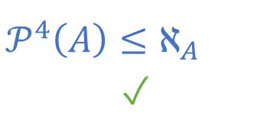


Sierpiński‘s Theorem [1947]
Generalized continuum hypothesis $→$ Well-ordering theorem $→$ Axiom of choice
Fix a set $A$ (w.l.o.g. large enough).
We show $A≤ℵ_{A}$.
$$ℵ_{A}≤𝒫^{4}(A)$$
$$𝒫^{4}\left(A\right)≤ℵ_{A}$$
✓
$$𝒫^{3}(A)$$
$$<$$
$$𝒫^{3}\left(A\right)+ℵ_{A}$$
$$∼$$
$$𝒫^{4}(A)$$

Slide 33


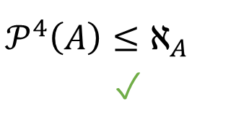


Sierpiński‘s Theorem [1947]
Generalized continuum hypothesis $→$ Well-ordering theorem $→$ Axiom of choice
Fix a set $A$ (w.l.o.g. large enough).
We show $A≤ℵ_{A}$.
$$ℵ_{A}≤𝒫^{4}(A)$$
$$𝒫^{4}\left(A\right)≤ℵ_{A}$$
✓
$$𝒫^{3}(A)$$
$$∼$$
$$𝒫^{3}\left(A\right)+ℵ_{A}$$
$$<$$
$$𝒫^{4}(A)$$

Slide 34



Sierpiński‘s Theorem [1947]
Generalized continuum hypothesis $→$ Well-ordering theorem $→$ Axiom of choice
Fix a set $A$ (w.l.o.g. large enough).
We show $A≤ℵ_{A}$.
$$ℵ_{A}≤𝒫^{4}(A)$$
$$ℵ_{A}≤𝒫^{3}(A)$$
$$𝒫^{4}\left(A\right)≤ℵ_{A}$$
✓
$$𝒫^{3}(A)$$
$$≥$$
$$𝒫^{3}\left(A\right)+ℵ_{A}$$
$$<$$
$$𝒫^{4}(A)$$

Slide 35





Sierpiński‘s Theorem [1947]
Generalized continuum hypothesis $→$ Well-ordering theorem $→$ Axiom of choice
Fix a set $A$ (w.l.o.g. large enough).
We show $A≤ℵ_{A}$.
$$ℵ_{A}≤𝒫^{4}(A)$$
$$ℵ_{A}≤𝒫^{3}(A)$$
$$𝒫^{4}\left(A\right)≤ℵ_{A}$$
✓
$$𝒫^{2}(A)$$
$$≤$$
$$𝒫^{2}\left(A\right)+ℵ_{A}$$
$$≤$$
$$𝒫^{3}(A)$$

Slide 36
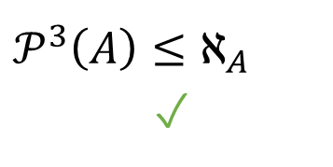





Sierpiński‘s Theorem [1947]
Generalized continuum hypothesis $→$ Well-ordering theorem $→$ Axiom of choice
Fix a set $A$ (w.l.o.g. large enough).
We show $A≤ℵ_{A}$.
$$ℵ_{A}≤𝒫^{4}(A)$$
$$ℵ_{A}≤𝒫^{3}(A)$$
$$𝒫^{4}\left(A\right)≤ℵ_{A}$$
✓
$$𝒫^{3}\left(A\right)≤ℵ_{A}$$
✓
$$𝒫^{2}(A)$$
$$<$$
$$𝒫^{2}\left(A\right)+ℵ_{A}$$
$$∼$$
$$𝒫^{3}(A)$$

Slide 37






Sierpiński‘s Theorem [1947]
Generalized continuum hypothesis $→$ Well-ordering theorem $→$ Axiom of choice
Fix a set $A$ (w.l.o.g. large enough).
We show $A≤ℵ_{A}$.
$$ℵ_{A}≤𝒫^{4}(A)$$
$$ℵ_{A}≤𝒫^{3}(A)$$
$$𝒫^{4}\left(A\right)≤ℵ_{A}$$
✓
$$ℵ_{A}≤𝒫^{2}(A)$$
$$𝒫^{3}\left(A\right)≤ℵ_{A}$$
✓
$$𝒫^{2}(A)$$
$$∼$$
$$𝒫^{2}\left(A\right)+ℵ_{A}$$
$$<$$
$$𝒫^{3}(A)$$

Slide 38

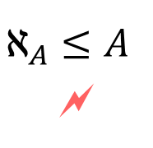


Sierpiński‘s Theorem [1947]
Generalized continuum hypothesis $→$ Well-ordering theorem $→$ Axiom of choice
Fix a set $A$ (w.l.o.g. large enough).
We show $A≤ℵ_{A}$.
$$ℵ_{A}≤𝒫^{4}(A)$$
$$ℵ_{A}≤𝒫^{3}(A)$$
$$𝒫^{4}\left(A\right)≤ℵ_{A}$$
✓
$$ℵ_{A}≤𝒫^{2}(A)$$
$$𝒫^{3}\left(A\right)≤ℵ_{A}$$
✓
$$ℵ_{A}≤𝒫(A)$$
$$𝒫^{2}\left(A\right)≤ℵ_{A}$$
✓
$$ℵ_{A}≤A$$
🗲
$$𝒫\left(A\right)≤ℵ_{A}$$
✓

Slide 39

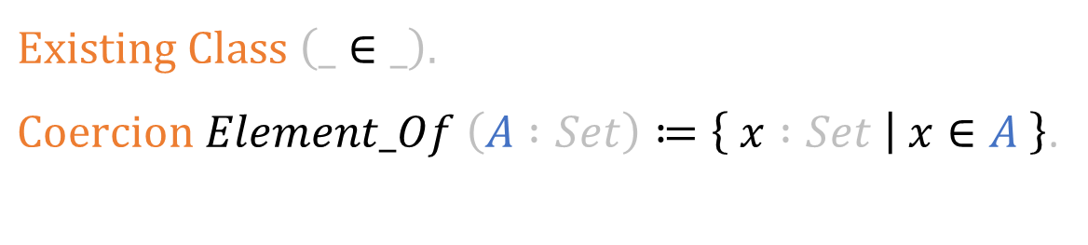
Sets as Types
$$Existing Class \left(_∈_\right).$$
$Coercion Element_Of \left(A :Set\right)≔\left\{ x :Set | x∈A \right\}$.
$$A→B$$
stands for
$$\left\{ x :Set | x∈A \right\}→\left\{ y :Set | y∈B \right\}$$

Slide 40


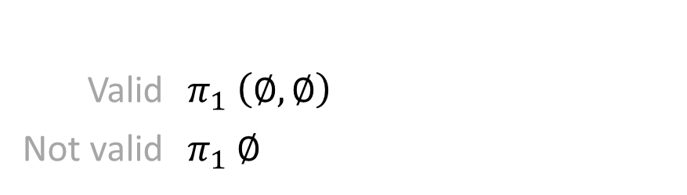



Advantages of Sets as Types
Reusable Definitions and Notations
$$∀ x :𝒫 A, x⊆A$$
$$λ x :𝒫 A⇒A∖x$$
$$f :Surjection A (𝒫 A)$$
$$R :Order (𝒫 A)$$
Tracking and Checking of Types
$$\left\{ n∈ℕ | n is even \right\} : 𝒫 ℕ$$
$$π_{1} :∀\{A,B :Set\}. A×B→A$$
Valid | $$π_{1} \left(∅,∅\right)$$
Not valid | $$π_{1} ∅$$

Slide 41
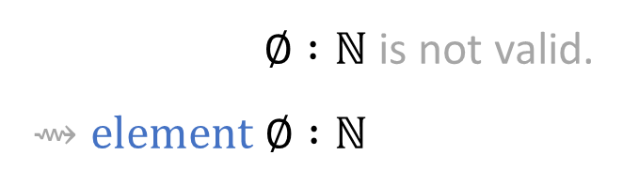

Problems with Sets as Types
$∅ :ℕ$ is not valid.
$⇝element ∅ :ℕ$
$$x=y \underset{→}{?} element x=element y$$
$$⋮$$

Slide 42

Eliminators on Sets
Inspired by recursion schemes in Coq:
$$numeral_rec :∀ A :Set.A → \left(ℕ →A →A\right) → ℕ → A$$
Not into arbitrary types!

Slide 43
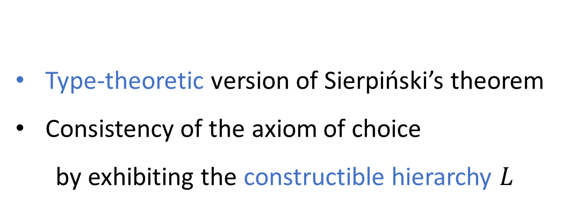

Conclusion
Higher-order axiomatisation of set theory
Hartogs number as a big ordinal ($ℵ_{A}≰A$)
Sierpiński‘s theorem:
  Under GCH, the Hartogs number is big enough. ($ℵ_{A}≥A$)
Main result formalized in Coq (XM + FE)
Thank you!
Next Goals
Type-theoretic version of Sierpiński’s theorem
Consistency of the axiom of choice
  by exhibiting the constructible hierarchy $L$

Slide 44
References
Dominik Kirst and Gert Smolka.
Categoricity results for second-order ZF in dependent type theory.
International Conference on Interactive Theorem Proving. Springer, Cham, 2017.
Friedrich Hartogs.
Über das Problem der Wohlordnung.
Mathematische Annalen 76.4 (1915): 438-443.
Wacław Sierpiński.
L'hypothèse généralisée du continu et l'axiome du choix.
Fundamenta Mathematicae 1.34 (1947): 1-5.

